Slide 1
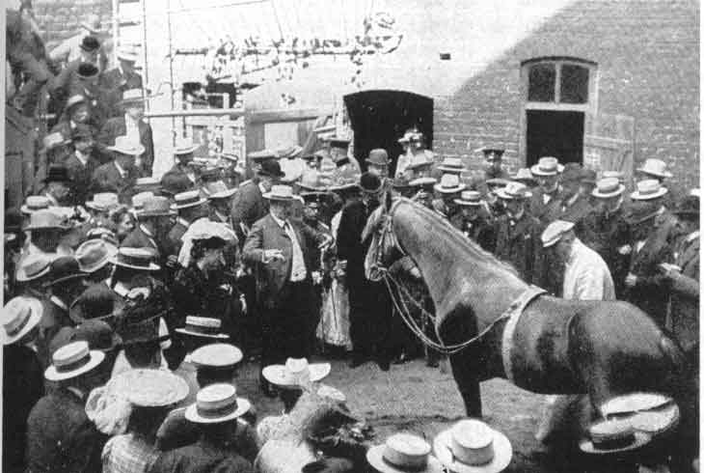
Model interpretability for chemical machine learning
Michael Yusov

Slide 2
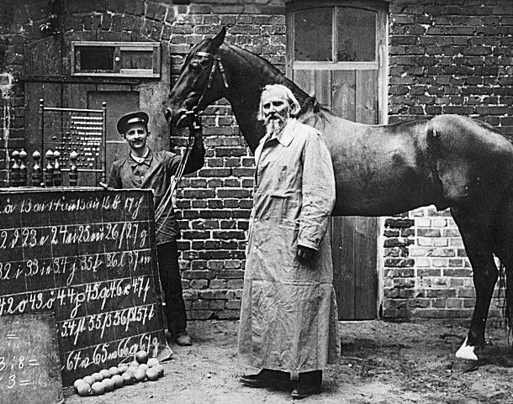
Clever Hans
“In the field of artificial intelligence, the Clever Hans effect describes a phenomenon where an algorithm seems to make correct predictions without having the relevant data and/or by using incorrect reasoning.” —Wikipedia
https://en.wikipedia.org/wiki/Clever_Hans

Slide 3
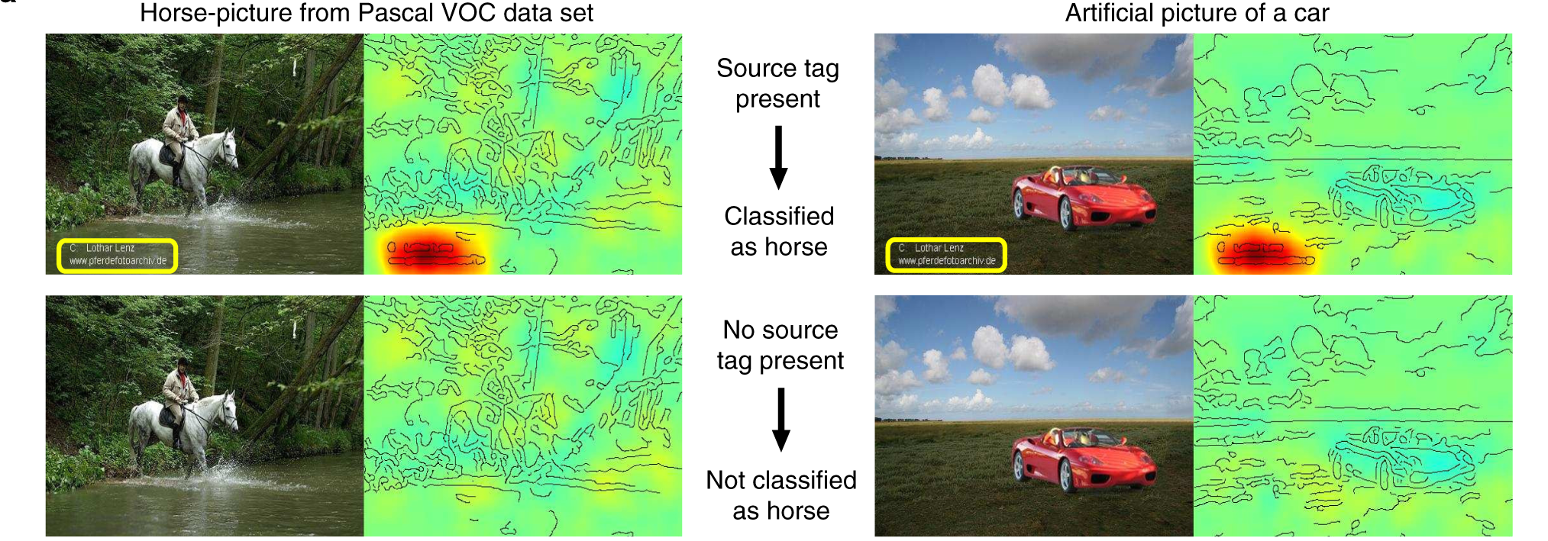
The Clever Hans effect in AI
Lapuschkin, S. et al. Unmasking Clever Hans predictors and assessing what machines really learn. Nat. Commun. 10, 1096 (2019). https://doi.org/10.1038/s41467-019-08987-4

Slide 4
What is model interpretability?
Definition: Model interpretability is the extent to which a human can understand how a machine learning model uses input features to produce predictions, including why a particular prediction was made and what relationships the model has learned.
In this lecture, we use “interpretability” and “explainability” interchangeably.

Slide 5
Why study model interpretability for chemical machine learning?
We study interpretability to:
avoid blindly trusting predictive performance and check whether the model learned meaningful features,
generate scientific insight and make predictions actionable,
build trust with collaborators or debug models
The goal of science is to gain knowledge; knowing why a model made certain predictions can help us learn more about the chemistry we are studying.
Interpretable machine learning allows the model itself to become the source of knowledge instead of the data.

Slide 6
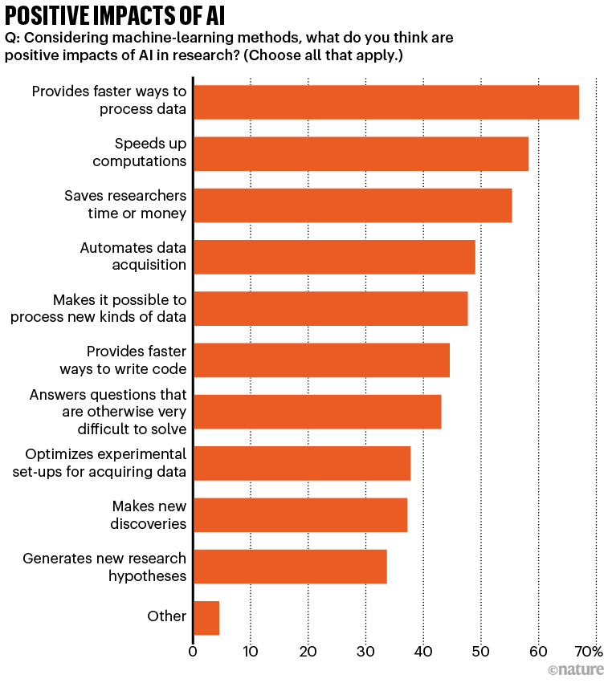
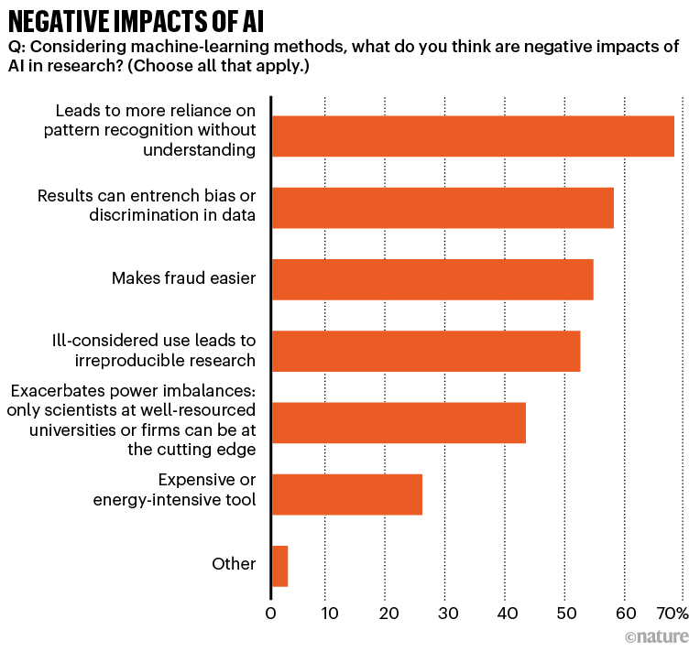
“AI and science: what 1,600 researchers think” (September 2023)
Van Noorden, R. & Perkel, J. M. AI and science: what 1,600 researchers think. Nature 621, 672–675 (2023). https://doi.org/10.1038/d41586-023-02980-0

Slide 7
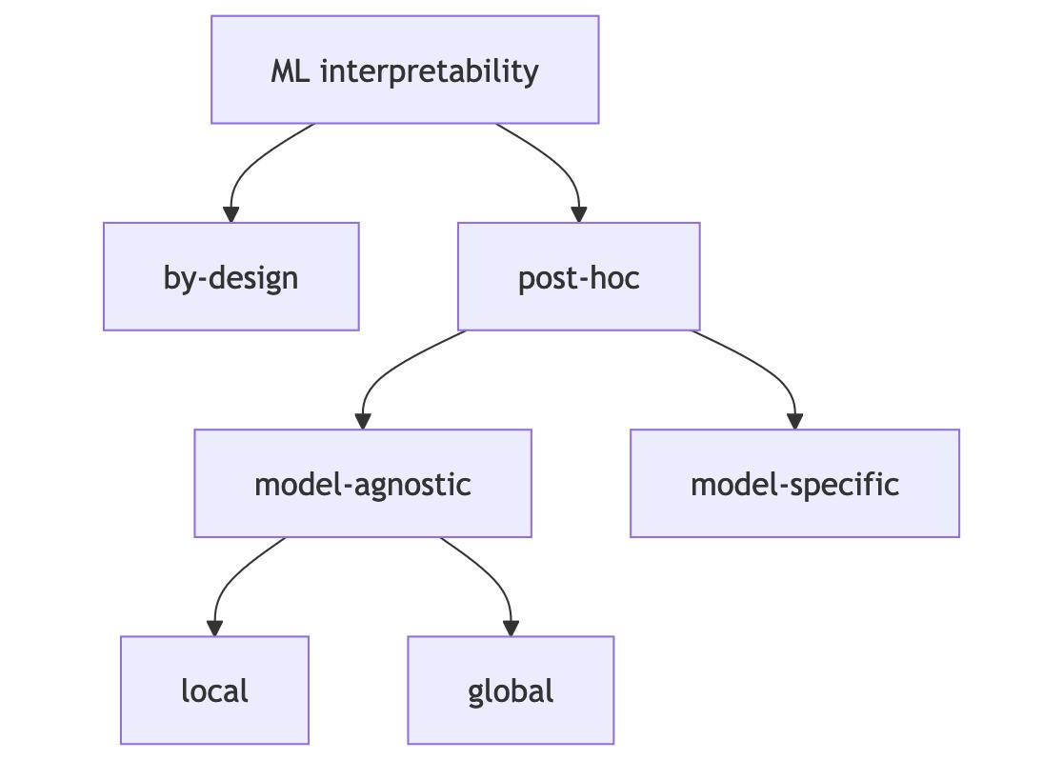
Taxonomy of interpretability methods
the model itself is understandable
first train a model and then analyze it afterward
asks why one prediction was made
asks what the model learned overall
Molnar, C. Interpretable Machine Learning: A Guide for Making Black Box Models Explainable 3rd edn. (2025). https://christophm.github.io/interpretable-ml-book/

Slide 8
Interpretability by design
Molnar, C. Interpretable Machine Learning: A Guide for Making Black Box Models Explainable 3rd edn. (2025). https://christophm.github.io/interpretable-ml-book/

Slide 9
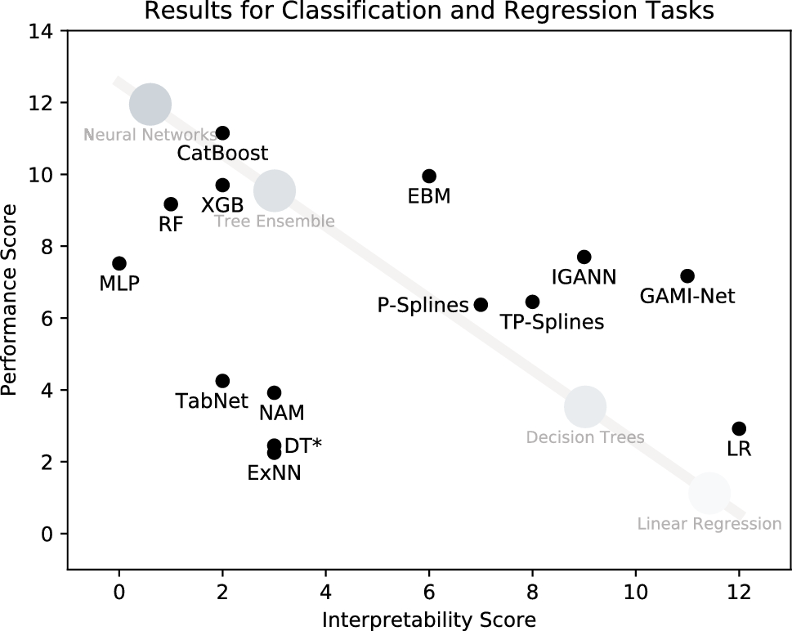
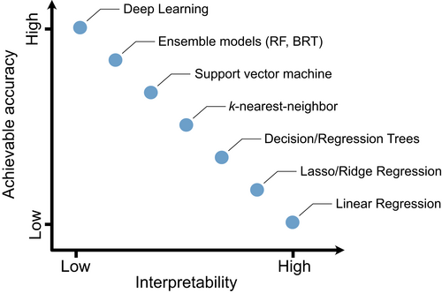
A common misconception: the performance-interpretability trade-off
Pichler, M. & Hartig, F. Machine learning and deep learning—A review for ecologists. Methods Ecol. Evol. 14, 994–1016 (2023). https://doi.org/10.1111/2041-210X.14061
Kruschel, S. et al. Challenging the performance-interpretability trade-off: An evaluation of interpretable machine learning models. Bus. Inf. Syst. Eng. 68, 159–183 (2026). https://doi.org/10.1007/s12599-024-00922-2

Slide 10
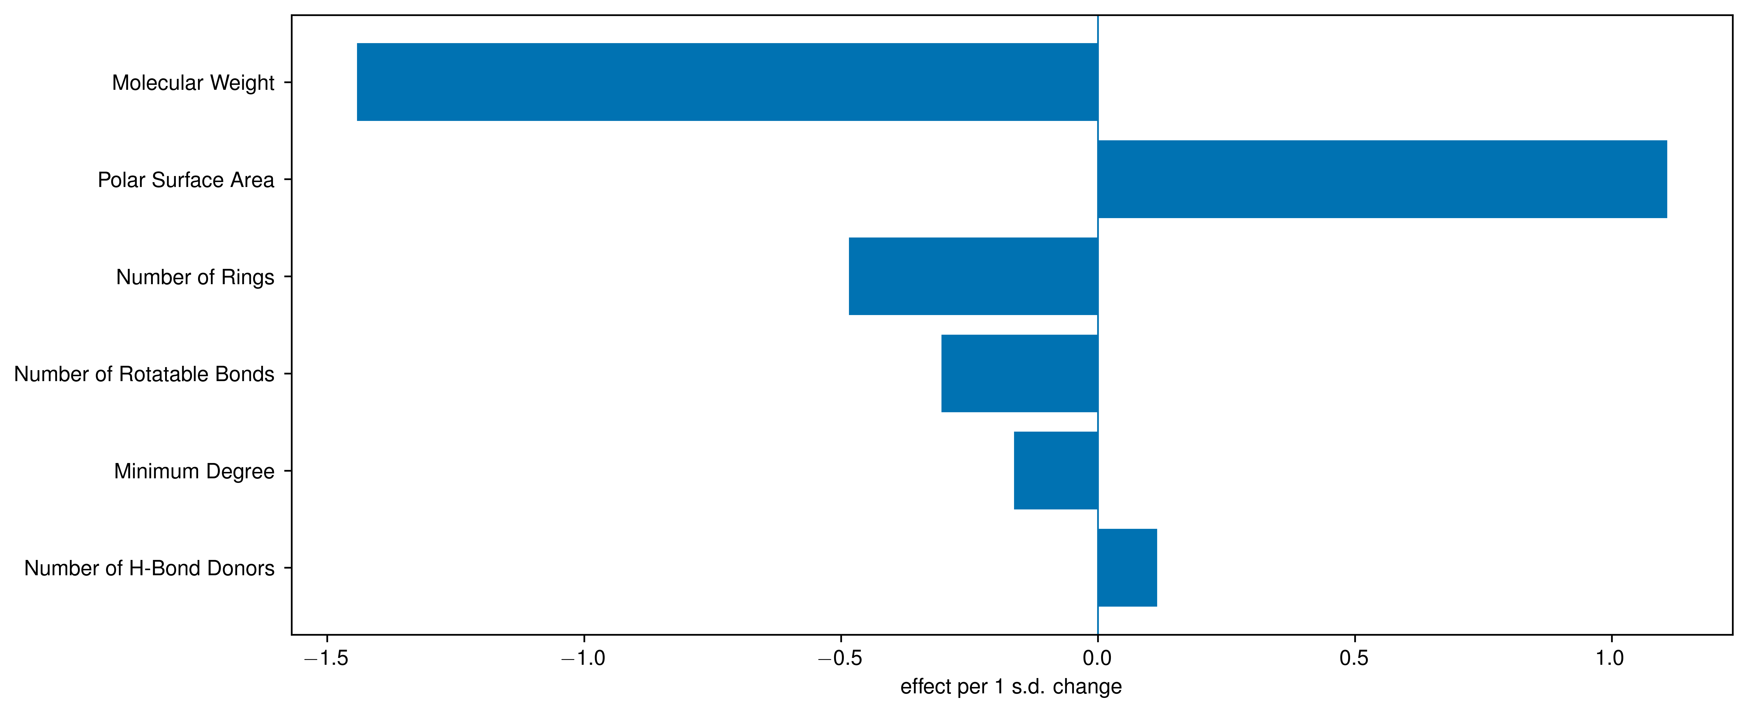

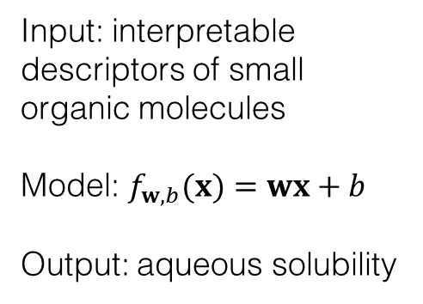
Interpretability by design: linear model coefficients
Input: interpretable descriptors of small organic molecules
Model: $f_{w,b}(x)=wx+b$
Output: aqueous solubility
$$R^{2}=0.71$$
We will use the Delaney/ESOL aqueous solubility dataset for this lecture

Slide 11
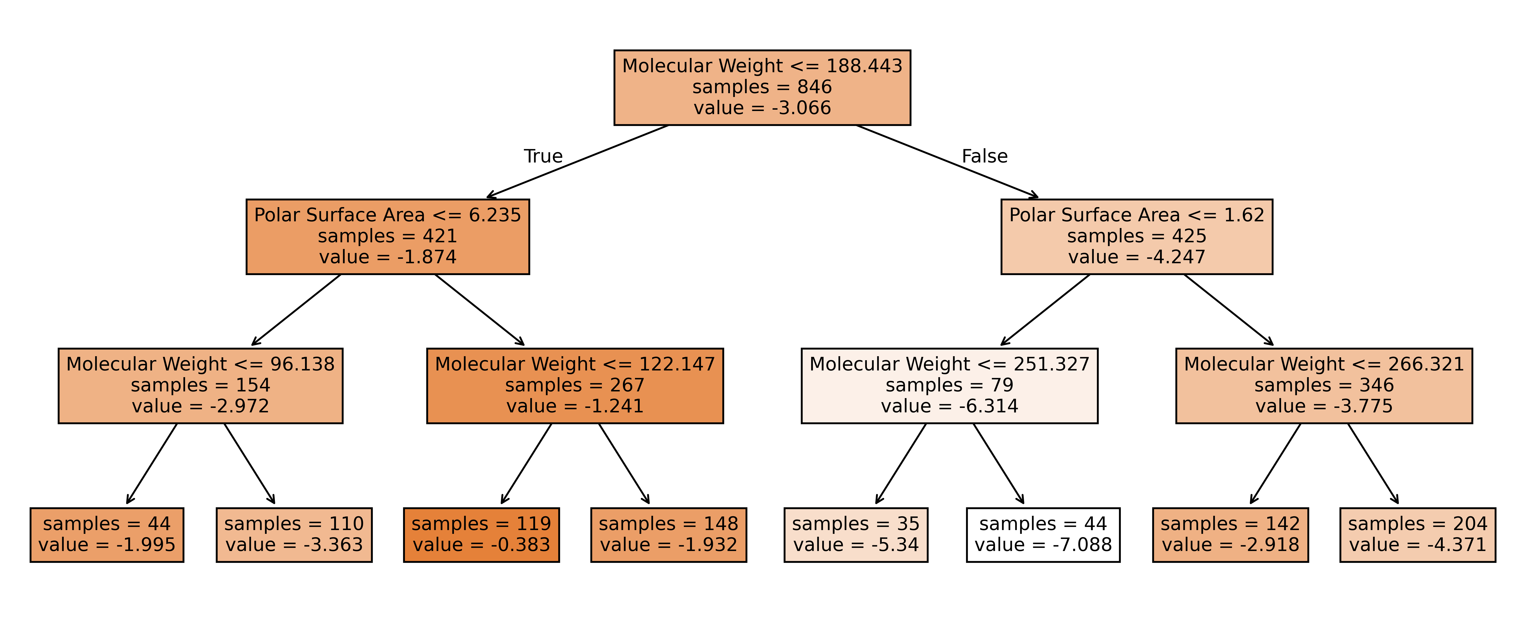
Interpretability by design: decision trees
Model: decision tree
$$R^{2}=0.69$$

Slide 12
Interpretability by design
Strengths
Limitations
Provides directly inspectable models whose structure is understandable from the start
Helps reveal simple trends, signs, rules, or constraints
Does not guarantee high predictive accuracy if the true relationship is highly nonlinear or interaction-rich
Can mislead when simple coefficients or rules are treated as mechanistic truth

Slide 13
Model-specific post-hoc interpretability
Molnar, C. Interpretable Machine Learning: A Guide for Making Black Box Models Explainable 3rd edn. (2025). https://christophm.github.io/interpretable-ml-book/

Slide 14
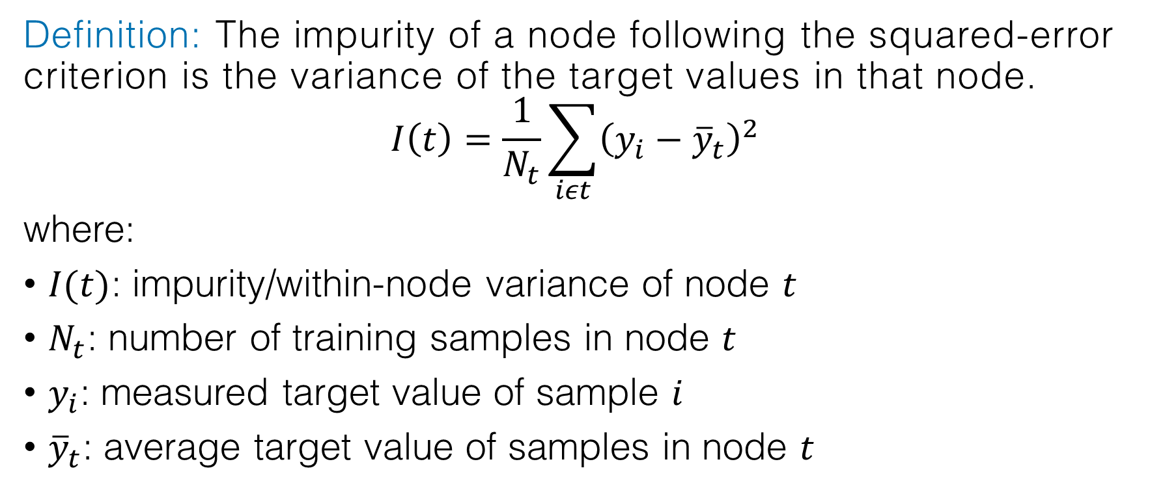
Model-specific post-hoc interpretability: mean decrease in impurity (MDI) for random forests and gradient boosted trees
Definition: The impurity of a node following the squared-error criterion is the variance of the target values in that node.
$$I\left(t\right)=\frac{1}{N_{t}}\sum_{iεt}{{\left(y_{i}−{\overline{y}}_{t}\right)}^{2}}$$
where:
$I(t)$: impurity/within-node variance of node $t$
$N_{t}$: number of training samples in node $t$
$y_{i}$: measured target value of sample $i$
${\overline{y}}_{t}$: average target value of samples in node $t$

Slide 15
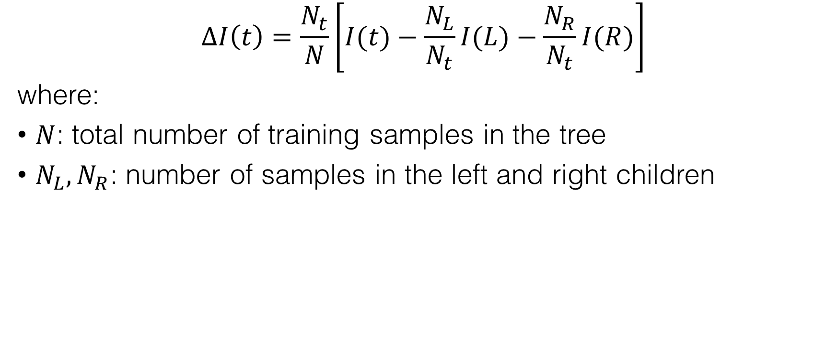


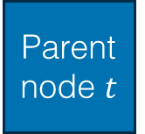
Model-specific post-hoc interpretability: mean decrease in impurity (MDI) for random forests and gradient boosted trees
$$∆I\left(t\right)=\frac{N_{t}}{N}\left[I(t)−\frac{N_{L}}{N_{t}}I(L)−\frac{N_{R}}{N_{t}}I(R)\right]$$
where:
$N$: total number of training samples in the tree
$N_{L},N_{R}$: number of samples in the left and right children
Parent node $t$
Split
criterion
Left child $L$
Right child $R$

Slide 16
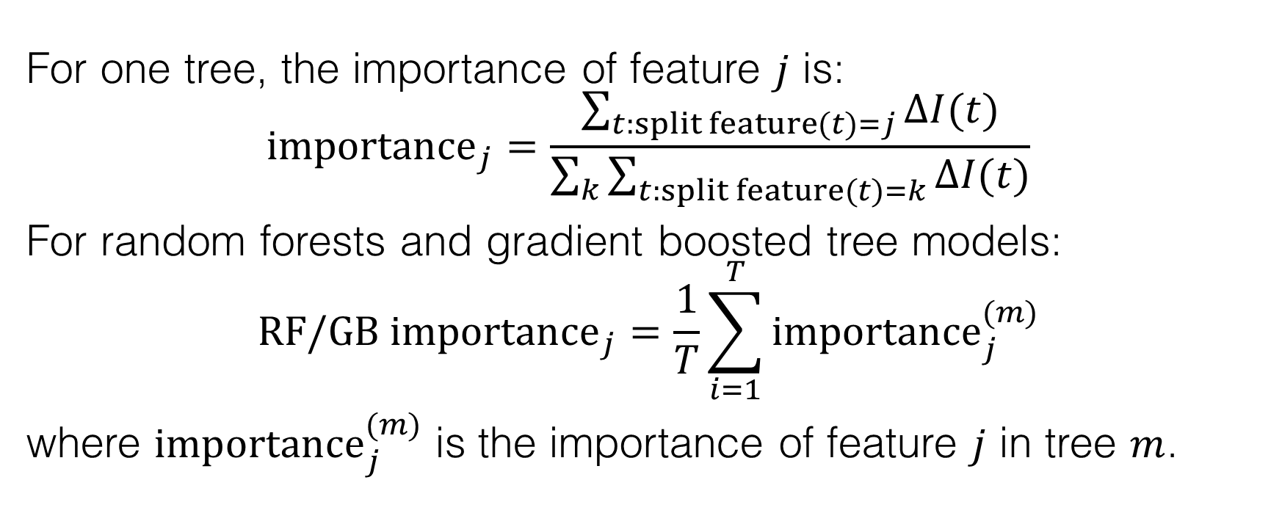
Model-specific post-hoc interpretability: mean decrease in impurity (MDI) for random forests and gradient boosted trees
For one tree, the importance of feature $j$ is:
$${importance}_{j}=\frac{\sum_{t:split feature(t)=j}{∆I(t)}}{\sum_{k}{\sum_{t:split feature(t)=k}{∆I(t)}}}$$
For random forests and gradient boosted tree models:
$${RF/GB importance}_{j}=\frac{1}{T}\sum_{i=1}^{T}{{importance}_{j}^{(m)}}$$
where ${importance}_{j}^{(m)}$ is the importance of feature $j$ in tree $m$.

Slide 17
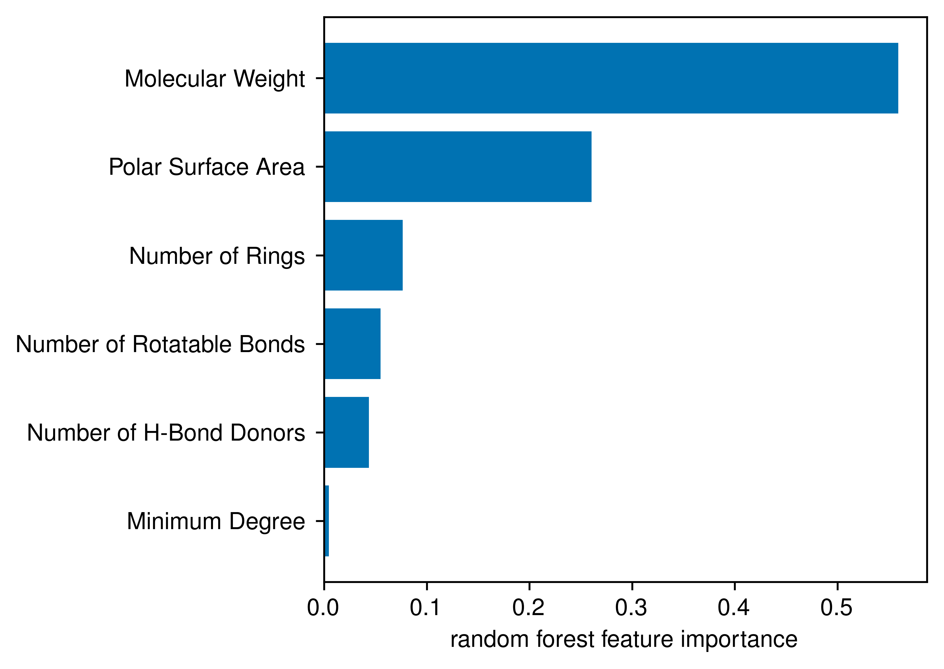
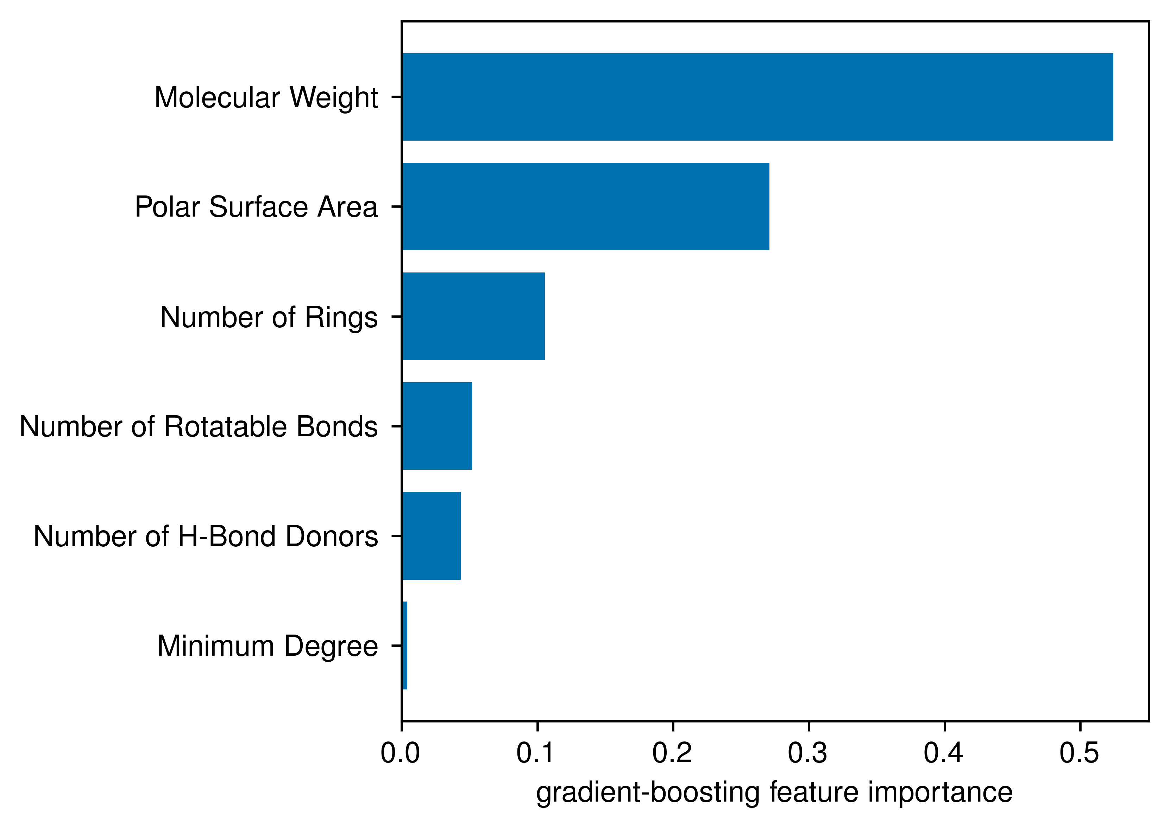


Model-specific post-hoc interpretability: mean decrease in impurity (MDI) for random forests and gradient boosted trees
Random forest
Gradient boosted tree
rf_model.feature_importances_
gb_model.feature_importances_
$$R^{2}=0.859$$
$$R^{2}=0.862$$

Slide 18
Model-specific post-hoc interpretability: mean decrease in impurity (MDI) for random forests and gradient boosted trees
Strengths
Limitations
Provides a fast global feature ranking for random forests and gradient boosted trees
Works well when you want a quick first look at which features helped trees make useful splits
Does not show direction or local effects because importances are unsigned and global
Sensitive to feature correlation because correlated features can receive biased/split importance

Slide 19
Local post-hoc model-agnostic local interpretability
Molnar, C. Interpretable Machine Learning: A Guide for Making Black Box Models Explainable 3rd edn. (2025). https://christophm.github.io/interpretable-ml-book/

Slide 20
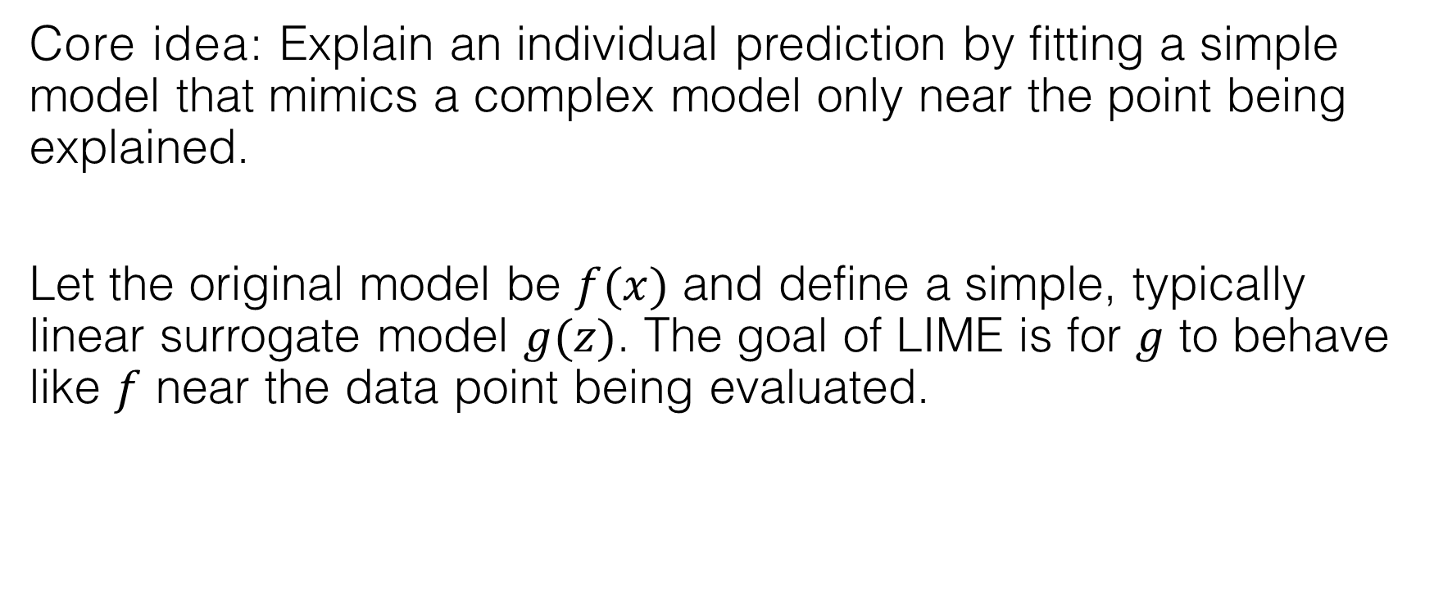
Local model-agnostic post-hoc interpretability: Local Interpretable Model-agnostic Explanations (LIME)
Core idea: Explain an individual prediction by fitting a simple model that mimics a complex model only near the point being explained.
Let the original model be $f(x)$ and define a simple, typically linear surrogate model $g(z)$. The goal of LIME is for $g$ to behave like $f$ near the data point being evaluated.

Slide 21

Local model-agnostic post-hoc interpretability: Local Interpretable Model-agnostic Explanations (LIME)
Example:
Step 1: Pick the molecule to explain
$$f_{gb}\left(x_{i}\right)=−3.252$$

Slide 22
Local model-agnostic post-hoc interpretability: Local Interpretable Model-agnostic Explanations (LIME)
Example:
Step 2: Generate perturbed versions of the molecule
Descriptor values:
Minimum Degree | Molecular Weight | Number of H-Bond Donors | Number of Rings | Number of Rotatable Bonds | Polar Surface Area
1 | 261.119 | 1 | 1 | 2 | 54.86
Generate 5000 perturbed samples nearby:
Minimum Degree | Molecular Weight | Number of H-Bond Donors | Number of Rings | Number of Rotatable Bonds | Polar Surface Area
0.997 | 69.567 | 3.301 | 2.000 | 2.564 | 39.467
0.911 | 226.866 | 3.222 | 3.064 | 9.390 | 0.000
0.918 | 455.888 | 0.000 | 4.111 | 2.352 | 95.249
$$f_{gb}\left(x_{i}\right)=−3.252$$
…

Slide 23

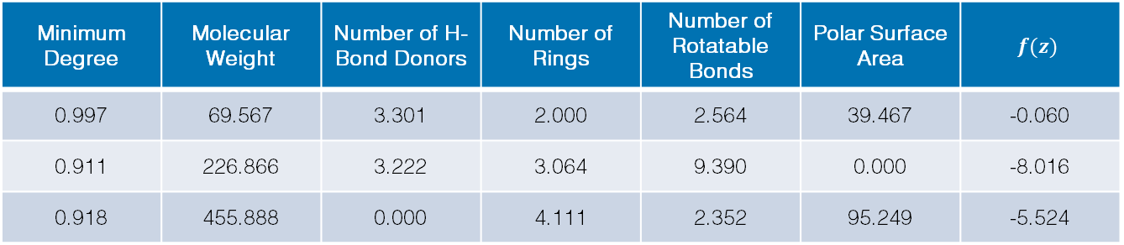
Local model-agnostic post-hoc interpretability: Local Interpretable Model-agnostic Explanations (LIME)
Example:
Step 3: Predict the perturbed samples with $f$
Minimum Degree | Molecular Weight | Number of H-Bond Donors | Number of Rings | Number of Rotatable Bonds | Polar Surface Area | $$f(z)$$
0.997 | 69.567 | 3.301 | 2.000 | 2.564 | 39.467 | -0.060
0.911 | 226.866 | 3.222 | 3.064 | 9.390 | 0.000 | -8.016
0.918 | 455.888 | 0.000 | 4.111 | 2.352 | 95.249 | -5.524
…
$$f_{gb}\left(x_{i}\right)=−3.252$$

Slide 24
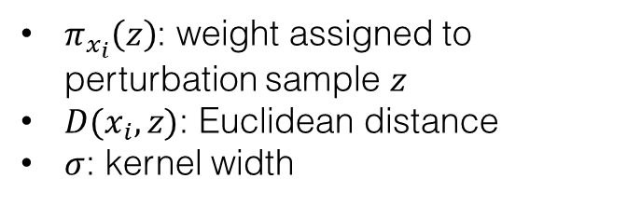
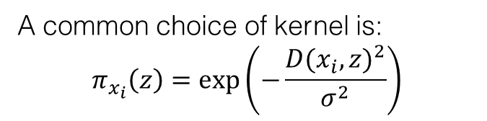
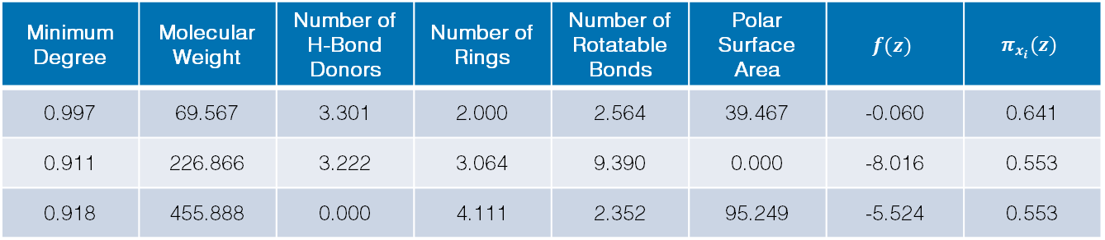
Local model-agnostic post-hoc interpretability: Local Interpretable Model-agnostic Explanations (LIME)
Example:
Step 4: Compute how close each perturbed sample is to the original molecule
Minimum Degree | Molecular Weight | Number of H-Bond Donors | Number of Rings | Number of Rotatable Bonds | Polar Surface Area | $$f(z)$$ | $$π_{x_{i}}(z)$$
0.997 | 69.567 | 3.301 | 2.000 | 2.564 | 39.467 | -0.060 | 0.641
0.911 | 226.866 | 3.222 | 3.064 | 9.390 | 0.000 | -8.016 | 0.553
0.918 | 455.888 | 0.000 | 4.111 | 2.352 | 95.249 | -5.524 | 0.553
…
$$f_{gb}\left(x_{i}\right)=−3.252$$
A common choice of kernel is:
$$π_{x_{i}}\left(z\right)=exp\left(−\frac{{D(x_{i},z)}^{2}}{σ^{2}}\right)$$
$π_{x_{i}}\left(z\right)$: weight assigned to perturbation sample $z$
$D(x_{i},z)$: Euclidean distance
$σ$: kernel width

Slide 25


Local model-agnostic post-hoc interpretability: Local Interpretable Model-agnostic Explanations (LIME)
Example:
Step 5: Fit a simple weighted surrogate model
$$g\left(z\right)=β_{0}+β_{1}z_{1}+β_{1}z_{2}+…+β_{p}z_{p}$$
$$ξ\left(x_{i}\right)=\underset{g∈G}{argmin}{\sum_{k=1}^{5000}{π_{x_{i}}(z_{k}){\left[f\left(z_{k}\right)−g(z_{k})\right]}^{2}}}$$
$${\left\|β\right\|}_{0}≤4$$
Using rule-based bins instead of feature coefficients,
$$g\left(z\right)=−3.279$$
$$+1.099∗I\left[26.30<Polar Surface Area≤56.79\right]$$
$$−0.685∗I\left[190.35<Molecular Weight≤278.06\right]$$
$$+0.151∗I\left[1.00<Number of Rotatable Bonds≤3.00\right]$$
$$−0.067∗I\left[Minimum Degree≤1.00\right]$$
$$f_{gb}\left(x_{i}\right)=−3.252$$
$$g\left(x_{i}\right)=−2.809$$
$$R^{2}=0.054$$

Slide 26
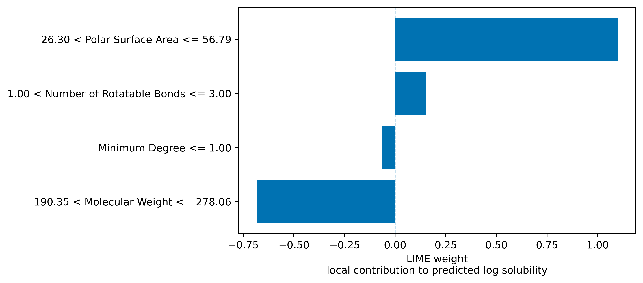
Local model-agnostic post-hoc interpretability: Local Interpretable Model-agnostic Explanations (LIME)
Example:
Step 5: Fit a simple weighted surrogate model
$$f_{gb}\left(x_{i}\right)=−3.252$$
$$g\left(x_{i}\right)=−2.809$$
$$R^{2}=0.054$$

Slide 27
Local model-agnostic post-hoc interpretability: Local Interpretable Model-agnostic Explanations (LIME)
Strengths
Limitations
Provides local, human-readable explanations for individual predictions
Works well when a simple local surrogate can approximate the black-box model near the sample being explained
Does not explain the black-box model directly; it explains a local surrogate approximation
Sensitive to perturbation strategy, random seed, kernel width, number of features, etc.
Can mislead when the local surrogate has poor fidelity

Slide 28
Global post-hoc model-agnostic local interpretability
Molnar, C. Interpretable Machine Learning: A Guide for Making Black Box Models Explainable 3rd edn. (2025). https://christophm.github.io/interpretable-ml-book/

Slide 29
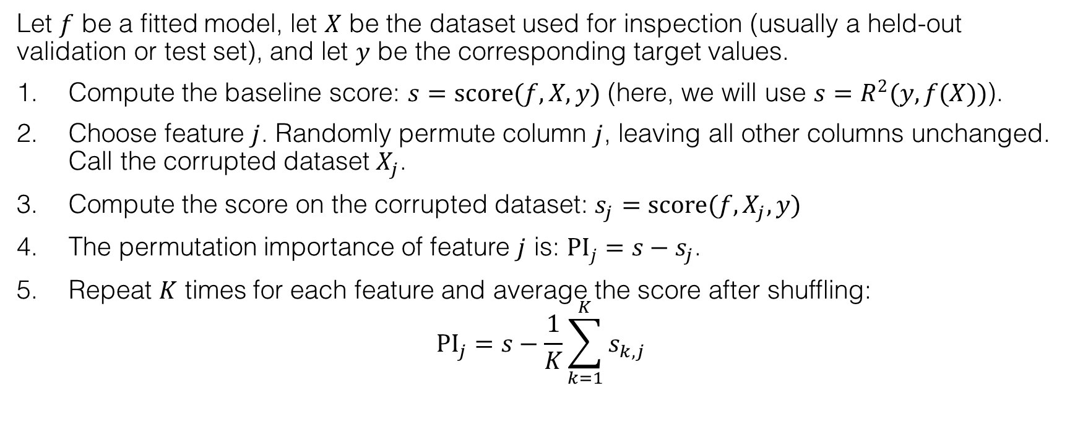
Global model-agnostic post-hoc interpretability: permutation importance
Let $f$ be a fitted model, let $X$ be the dataset used for inspection (usually a held-out validation or test set), and let $y$ be the corresponding target values.
Compute the baseline score: $s=score(f,X,y)$ (here, we will use $s=R^{2}(y,f(X))$).
Choose feature $j$. Randomly permute column $j$, leaving all other columns unchanged. Call the corrupted dataset $X_{j}$.
Compute the score on the corrupted dataset: $s_{j}=score(f,X_{j},y)$
The permutation importance of feature $j$ is: ${PI}_{j}=s−s_{j}$.
Repeat $K$ times for each feature and average the score after shuffling:
$${PI}_{j}=s−\frac{1}{K}\sum_{k=1}^{K}{s_{k,j}}$$

Slide 30
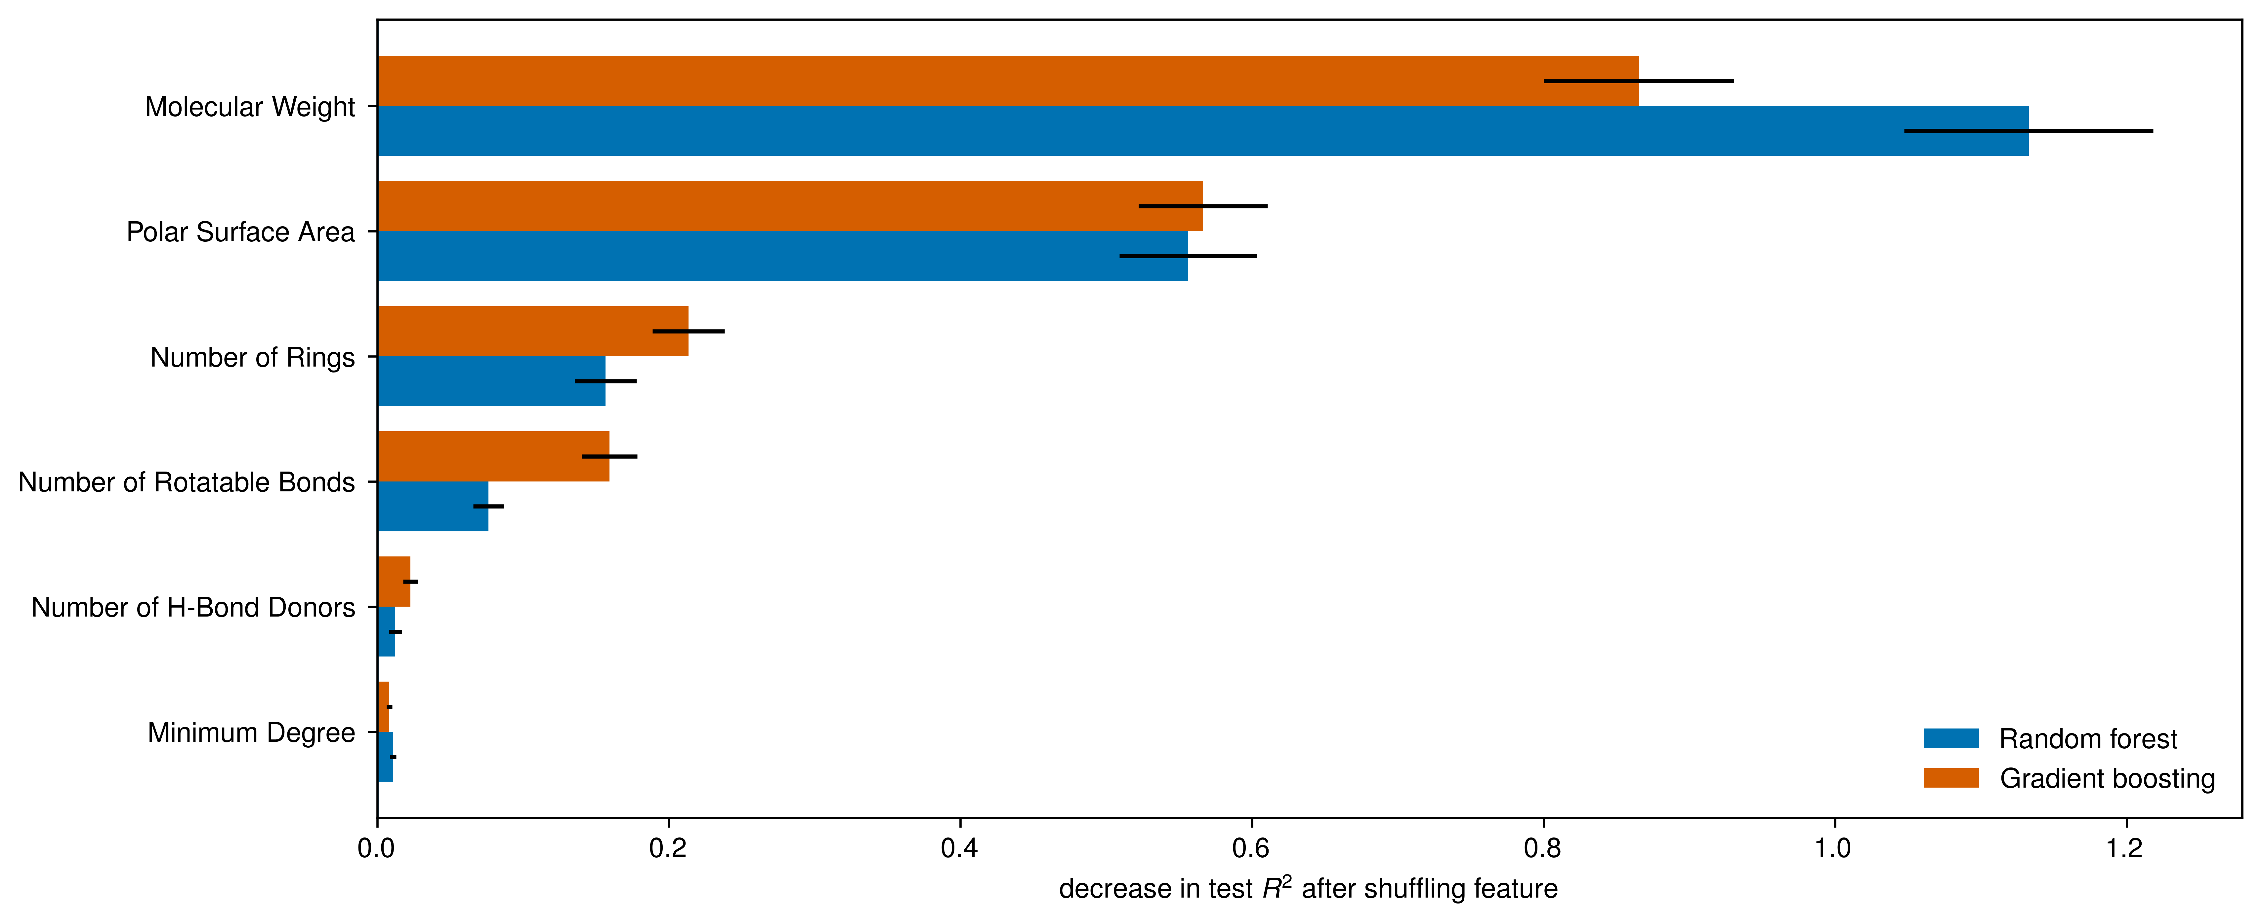
Global model-agnostic post-hoc interpretability: permutation importance

Slide 31
Global model-agnostic post-hoc interpretability: permutation importance
Strengths
Limitations
Provides a model-agnostic global feature ranking based on predictive performance
Helps reveal how much performance decreases when each feature’s information is destroyed
Does not show direction or local effects because it measures performance drop, not positive/negative contribution
Can mislead when redundant descriptors hide each other’s importance

Slide 32
Local & global post-hoc model-agnostic local interpretability
Molnar, C. Interpretable Machine Learning: A Guide for Making Black Box Models Explainable 3rd edn. (2025). https://christophm.github.io/interpretable-ml-book/

Slide 33
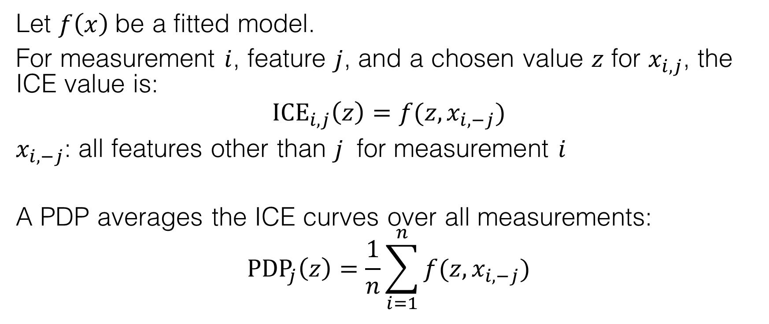
Local & global model-agnostic post-hoc interpretability: individual conditional expectation (ICE) and partial dependence plots (PDP)
Let $f\left(x\right)$be a fitted model.
For measurement $i$, feature $j$, and a chosen value $z$ for $x_{i,j}$, the ICE value is:
$${ICE}_{i,j}\left(z\right)=f(z,x_{i,−j})$$
$x_{i,−j}$: all features other than $j$ for measurement $i$
A PDP averages the ICE curves over all measurements:
$${PDP}_{j}\left(z\right)=\frac{1}{n}\sum_{i=1}^{n}{f(z,x_{i,−j})}$$

Slide 34
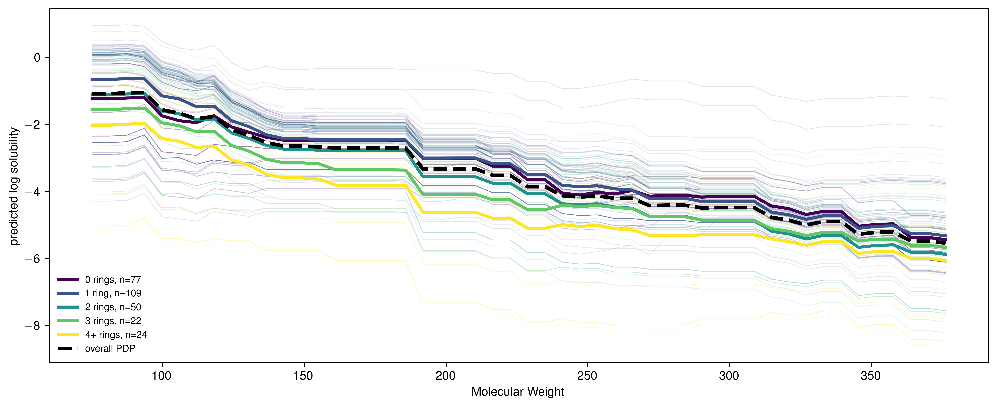
Local & global model-agnostic post-hoc interpretability: individual conditional expectation (ICE) and partial dependence plots (PDP)
ICE curves show a consistent decrease in predicted log solubility with increasing molecular weight.
Molecules with more rings tend to have lower predicted solubility at the same molecular weight.
Ring count primarily shifts the baseline prediction and does not fundamentally changing the molecular-weight dependence.

Slide 35
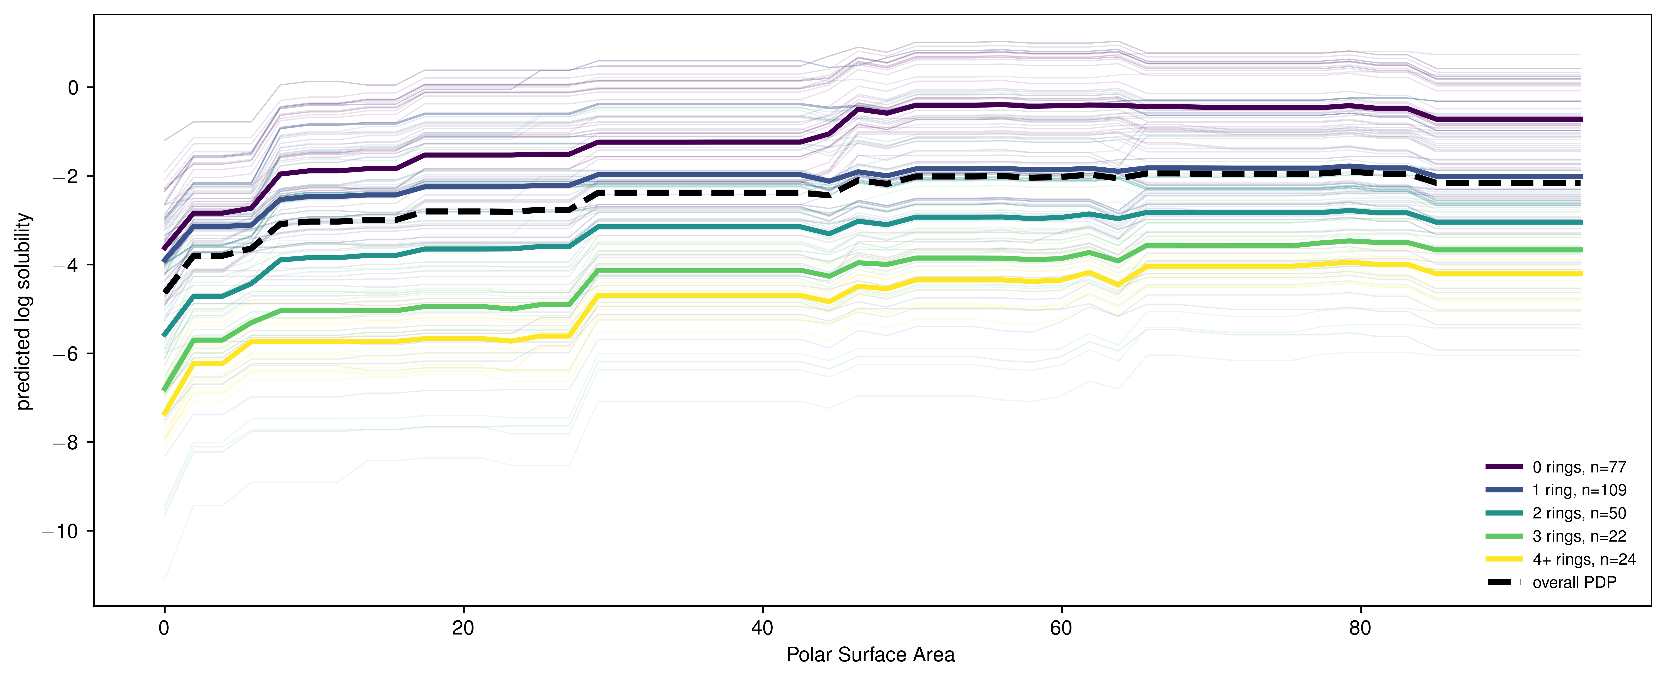
Local & global model-agnostic post-hoc interpretability: individual conditional expectation (ICE) and partial dependence plots (PDP)
ICE/PDP curves show that predicted log solubility increases with polar surface area, especially at low polar surface area, and then largely plateaus.
Molecules with more rings are predicted to be less soluble at the same polar surface area.
Ring count appears to shift the baseline prediction more than it changes the shape of the polar-surface-area dependence.

Slide 36
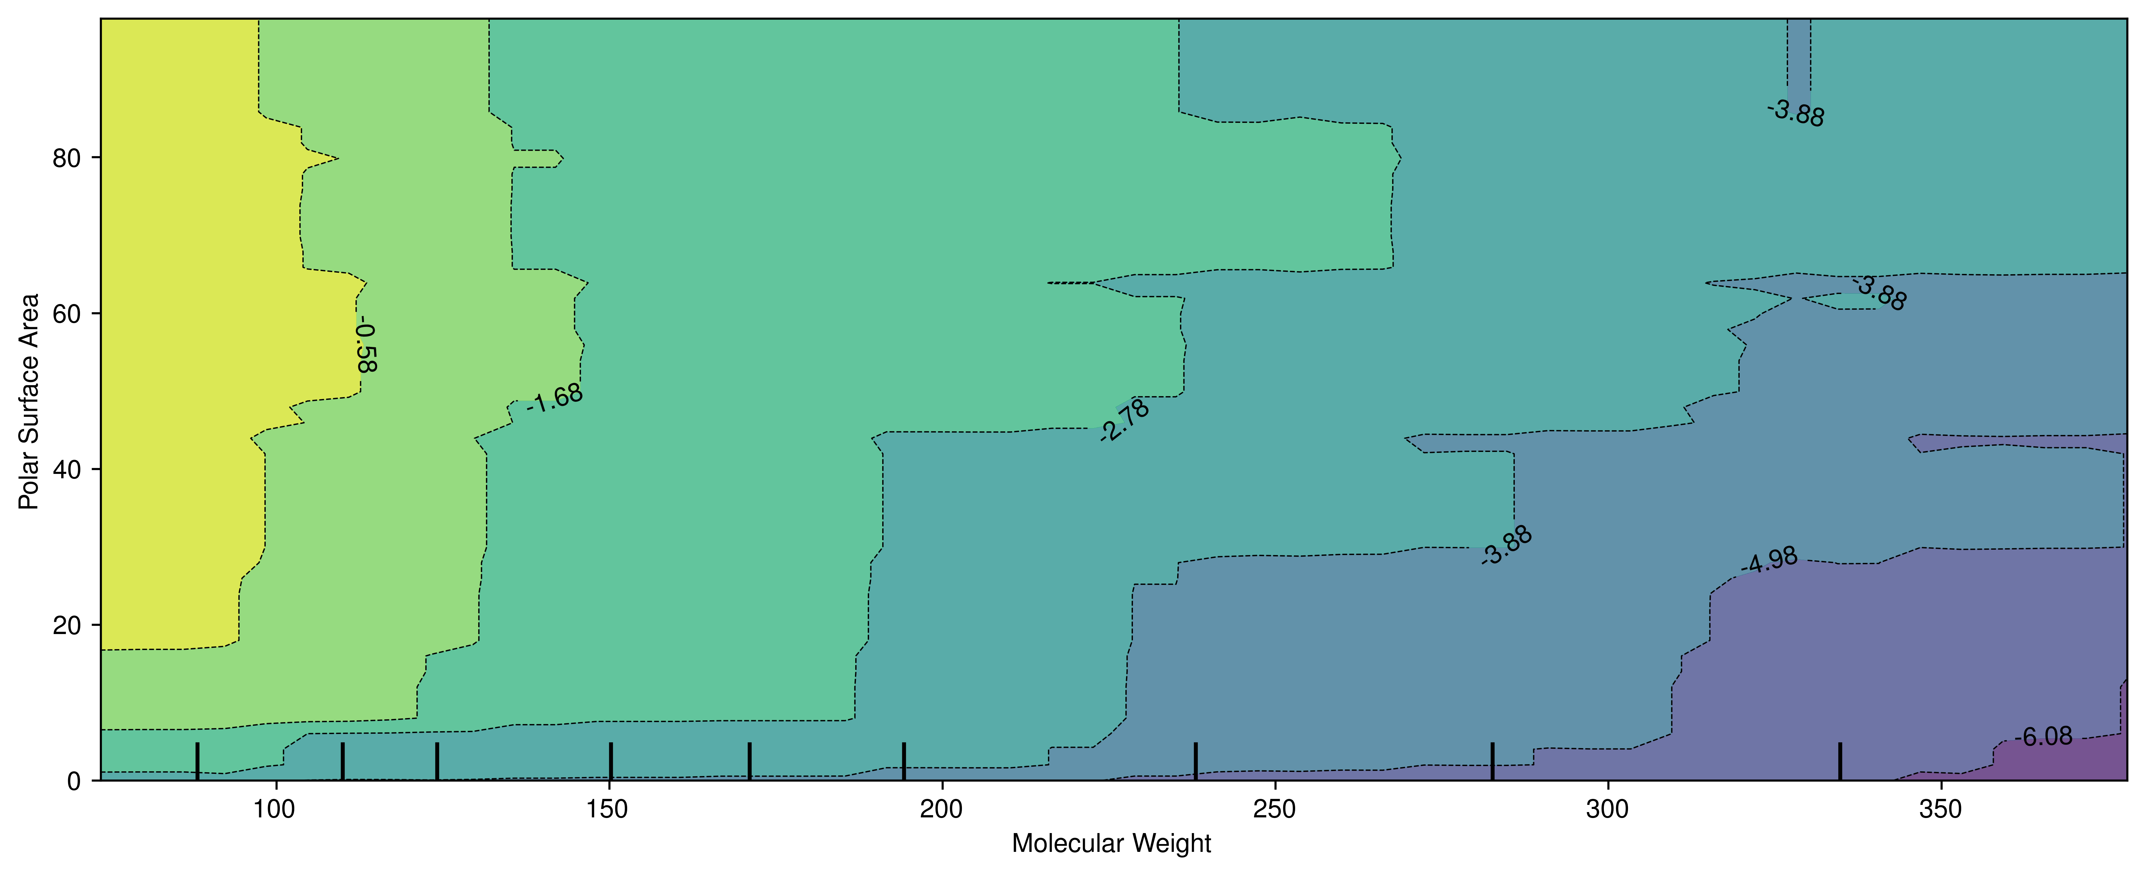
Local & global model-agnostic post-hoc interpretability: individual conditional expectation (ICE) and partial dependence plots (PDP)
Predicted log solubility decreases strongly with molecular weight and increases with polar surface area.
Polar surface area can partially compensate for high molecular weight, suggesting that the model has learned an interaction between molecular size and polarity.

Slide 37
Local & global model-agnostic post-hoc interpretability: individual conditional expectation (ICE) and partial dependence plots (PDP)
Strengths
Limitations
Works well when you want to move from “which features matter?” to “how does the model use this feature?”
Helps reveal direction, nonlinearity, thresholds, saturation, and heterogeneity across samples
Do not prove causal effects because they evaluate model behavior under artificial feature changes
Can mislead when PDP averages hide heterogeneous ICE behavior

Slide 38
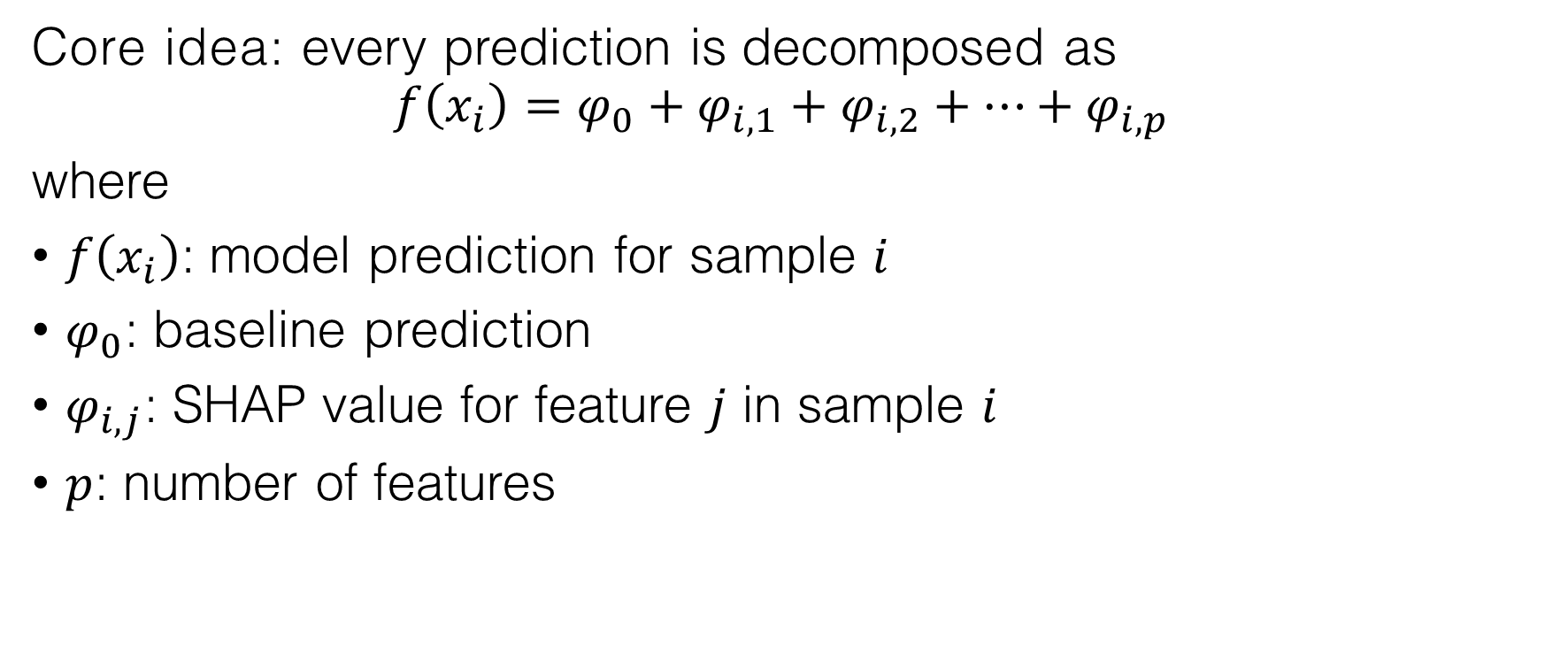
Local & global model-agnostic post-hoc interpretability: SHapley Additive exPlanations (SHAP)
Core idea: every prediction is decomposed as
$$f\left(x_{i}\right)=φ_{0}+φ_{i,1}+φ_{i,2}+…+φ_{i,p}$$
where
$f\left(x_{i}\right)$: model prediction for sample $i$
$φ_{0}$: baseline prediction
$φ_{i,j}$: SHAP value for feature $j$ in sample $i$
$p$: number of features

Slide 39
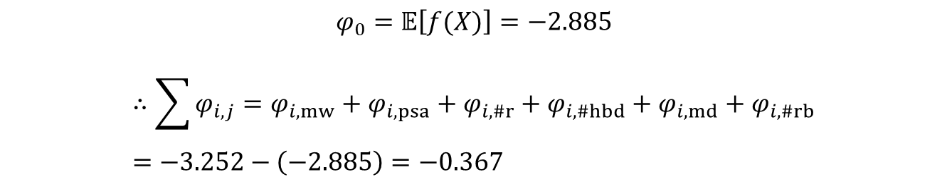

Local & global model-agnostic post-hoc interpretability: SHapley Additive exPlanations (SHAP)
Example:
$$f_{gb}\left(x_{i}\right)=−3.252$$
$$φ_{0}=𝔼\left[f(X)\right]=−2.885$$
$$∴\sum{φ_{i,j}}=φ_{i,mw}+φ_{i,psa}+φ_{i,\#r}+φ_{i,\#hbd}+φ_{i,md}+φ_{i,\#rb}=−3.252−\left(−2.885\right)=−0.367$$
How much did molecular weight, polar surface area, ring count, and the other descriptors push the predicted log solubility above or below a reference prediction?

Slide 40
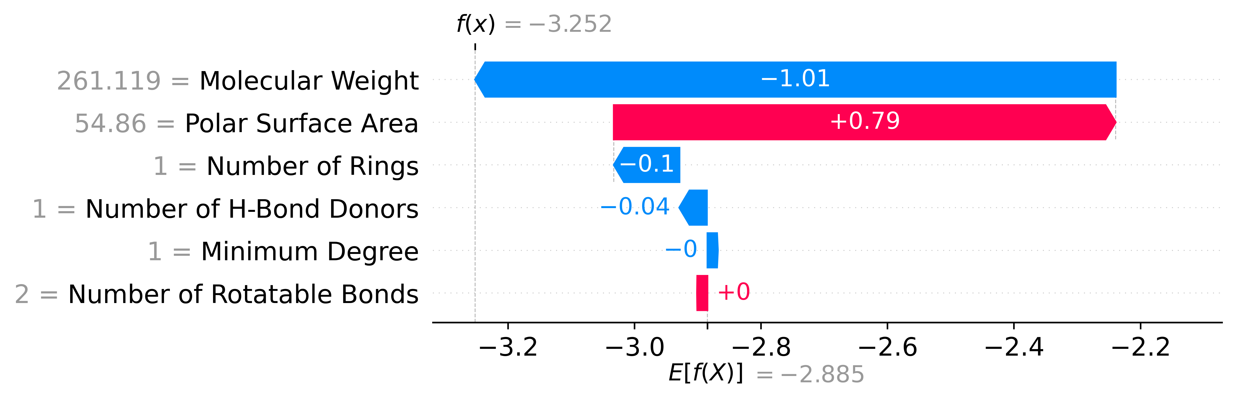
Local & global model-agnostic post-hoc interpretability: SHapley Additive exPlanations (SHAP)
Example:
$$f_{gb}\left(x_{i}\right)=−3.252$$
How much did molecular weight, polar surface area, ring count, and the other descriptors push the predicted log solubility above or below a reference prediction?

Slide 41
Local & global model-agnostic post-hoc interpretability: SHapley Additive exPlanations (SHAP)
Example:
Step 1: Pick the molecule to explain
$$f_{gb}\left(x_{i}\right)=−3.252$$

Slide 42


Local & global model-agnostic post-hoc interpretability: SHapley Additive exPlanations (SHAP)
Example:
Step 2: Choose a background dataset $X$
$X=$ X_train
$$f_{gb}\left(x_{i}\right)=−3.252$$

Slide 43
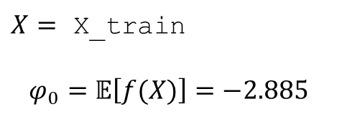
Local & global model-agnostic post-hoc interpretability: SHapley Additive exPlanations (SHAP)
Example:
Step 3: Compute the baseline prediction
$X=$ X_train
$$φ_{0}=𝔼\left[f(X)\right]=−2.885$$
$$f_{gb}\left(x_{i}\right)=−3.252$$

Slide 44
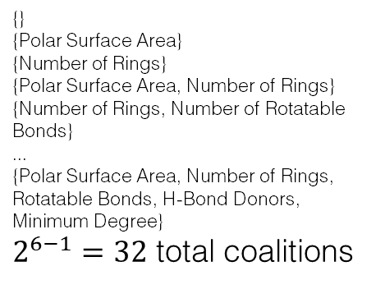
Local & global model-agnostic post-hoc interpretability: SHapley Additive exPlanations (SHAP)
Example:
Step 4: Consider all feature coalitions without molecular weight
$X=$ X_train
$$φ_{0}=𝔼\left[f(X)\right]=−2.885$$
{}
{Polar Surface Area}
{Number of Rings}
{Polar Surface Area, Number of Rings}
{Number of Rings, Number of Rotatable Bonds}
...
{Polar Surface Area, Number of Rings, Rotatable Bonds, H-Bond Donors, Minimum Degree}
$2^{6−1}=32$ total coalitions
$$f_{gb}\left(x_{i}\right)=−3.252$$

Slide 45
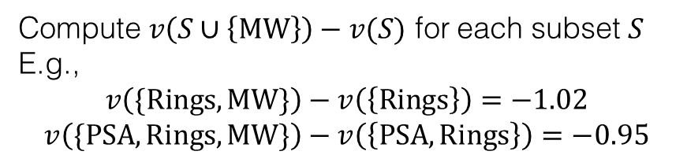
Local & global model-agnostic post-hoc interpretability: SHapley Additive exPlanations (SHAP)
Example:
Step 5: Measure what happens when molecular weight is added
$X=$ X_train
$$φ_{0}=𝔼\left[f(X)\right]=−2.885$$
Compute $v\left(S∪\left\{MW\right\}\right)−v(S)$ for each subset $S$
E.g.,
$$v\left(\{Rings,MW\}\right)−v\left(\left\{Rings\right\}\right)=−1.02$$
$$v\left(\{PSA, Rings,MW\}\right)−v\left(\left\{PSA,Rings\right\}\right)=−0.95$$
{}
{Polar Surface Area}
{Number of Rings}
{Polar Surface Area, Number of Rings}
{Number of Rings, Number of Rotatable Bonds}
...
{Polar Surface Area, Number of Rings, Rotatable Bonds, H-Bond Donors, Minimum Degree}
$2^{6−1}=32$ total coalitions
$$f_{gb}\left(x_{i}\right)=−3.252$$

Slide 46

Local & global model-agnostic post-hoc interpretability: SHapley Additive exPlanations (SHAP)
Example:
Step 6: Average all marginal contributions with Shapley weights
$X=$ X_train
$$φ_{0}=𝔼\left[f(X)\right]=−2.885$$
Compute $v\left(S∪\left\{MW\right\}\right)−v(S)$ for each subset $S$
E.g.,
$$v\left(\{Rings,MW\}\right)−v\left(\left\{Rings\right\}\right)=−1.02$$
$$v\left(\{PSA, Rings,MW\}\right)−v\left(\left\{PSA,Rings\right\}\right)=−0.95$$
$$φ_{MW}=\sum_{S⊆M\backslash \left\{MW\right\}}{\frac{\left|S\right|!\left(p−\left|S\right|−1\right)!}{p!}\left[v\left(S∪\left\{MW\right\}\right)−v(S)\right]}=−1.01$$
{}
{Polar Surface Area}
{Number of Rings}
{Polar Surface Area, Number of Rings}
{Number of Rings, Number of Rotatable Bonds}
...
{Polar Surface Area, Number of Rings, Rotatable Bonds, H-Bond Donors, Minimum Degree}
$2^{6−1}=32$ total coalitions
$$f_{gb}\left(x_{i}\right)=−3.252$$

Slide 47
Local & global model-agnostic post-hoc interpretability: SHapley Additive exPlanations (SHAP)
Example:
$$f_{gb}\left(x_{i}\right)=−3.252$$
How much did molecular weight, polar surface area, ring count, and the other descriptors push the predicted log solubility above or below a reference prediction?

Slide 48
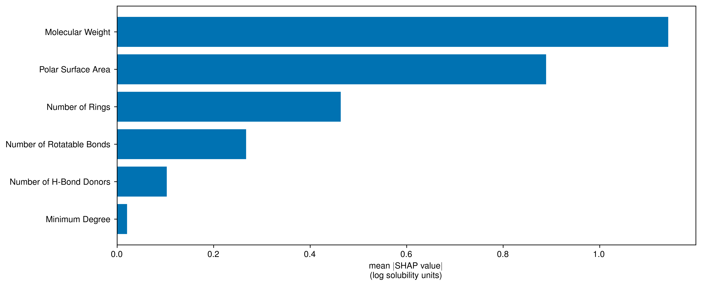
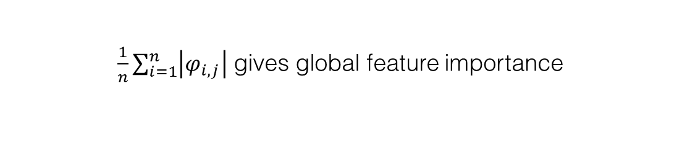
Local & global model-agnostic post-hoc interpretability: SHapley Additive exPlanations (SHAP)
$\frac{1}{n}\sum_{i=1}^{n}{\left|φ_{i,j}\right|}$ gives global feature importance

Slide 49
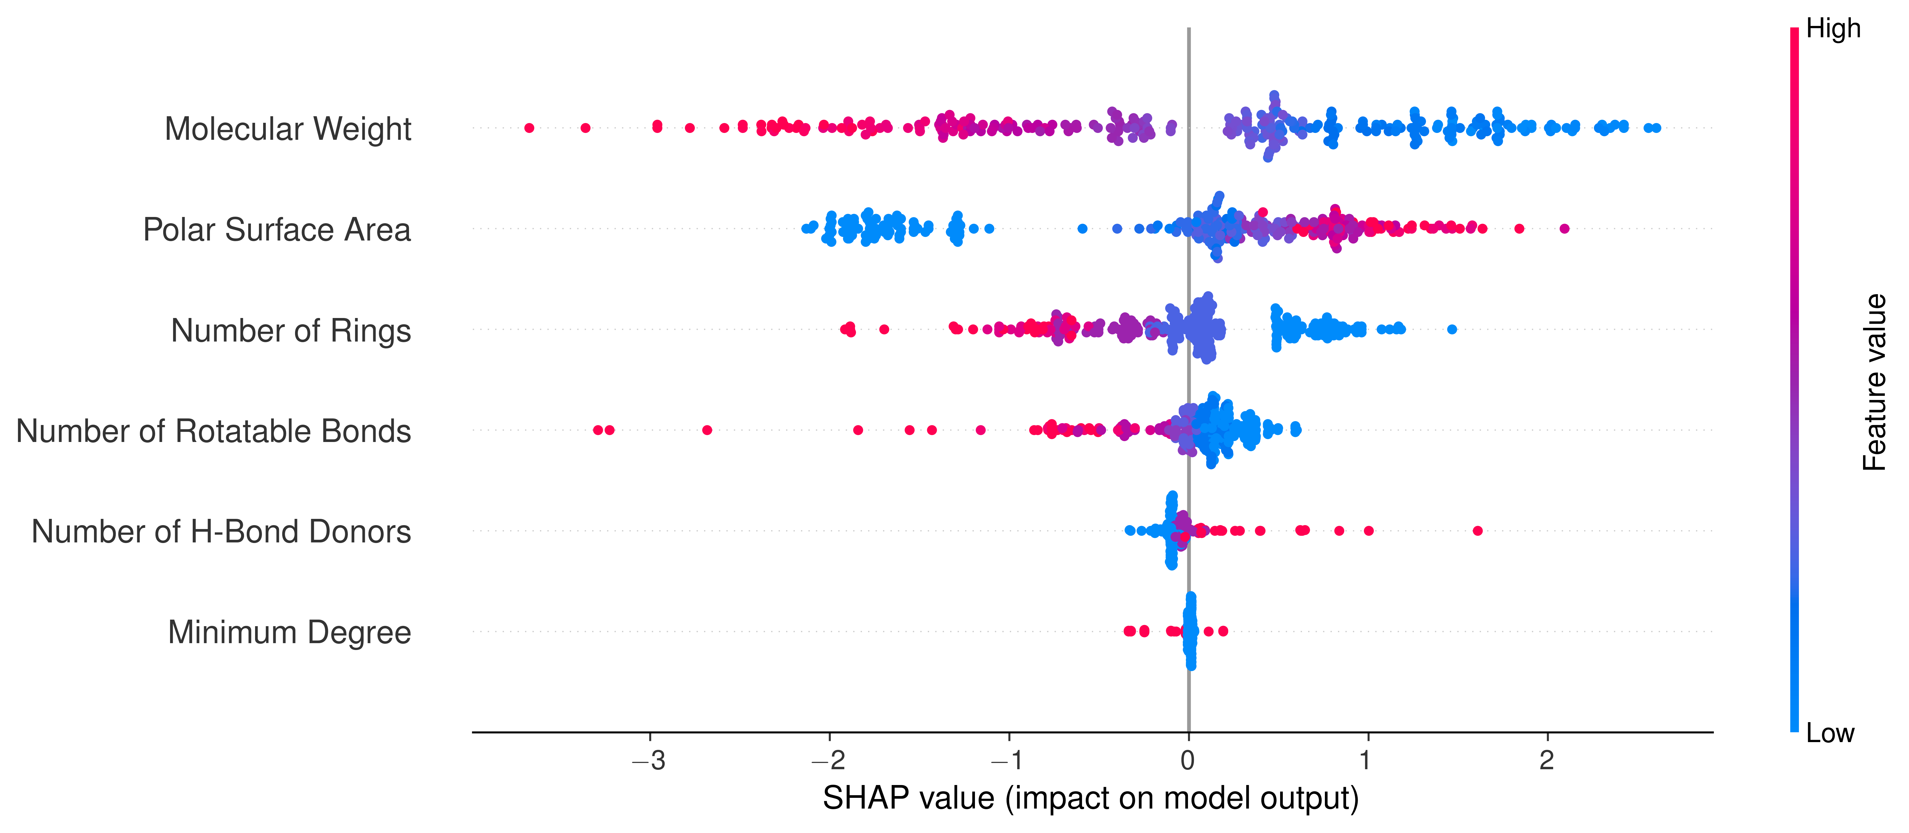
Local & global model-agnostic post-hoc interpretability: SHapley Additive exPlanations (SHAP)
$\frac{1}{n}\sum_{i=1}^{n}{\left|φ_{i,j}\right|}$ gives global feature importance

Slide 50
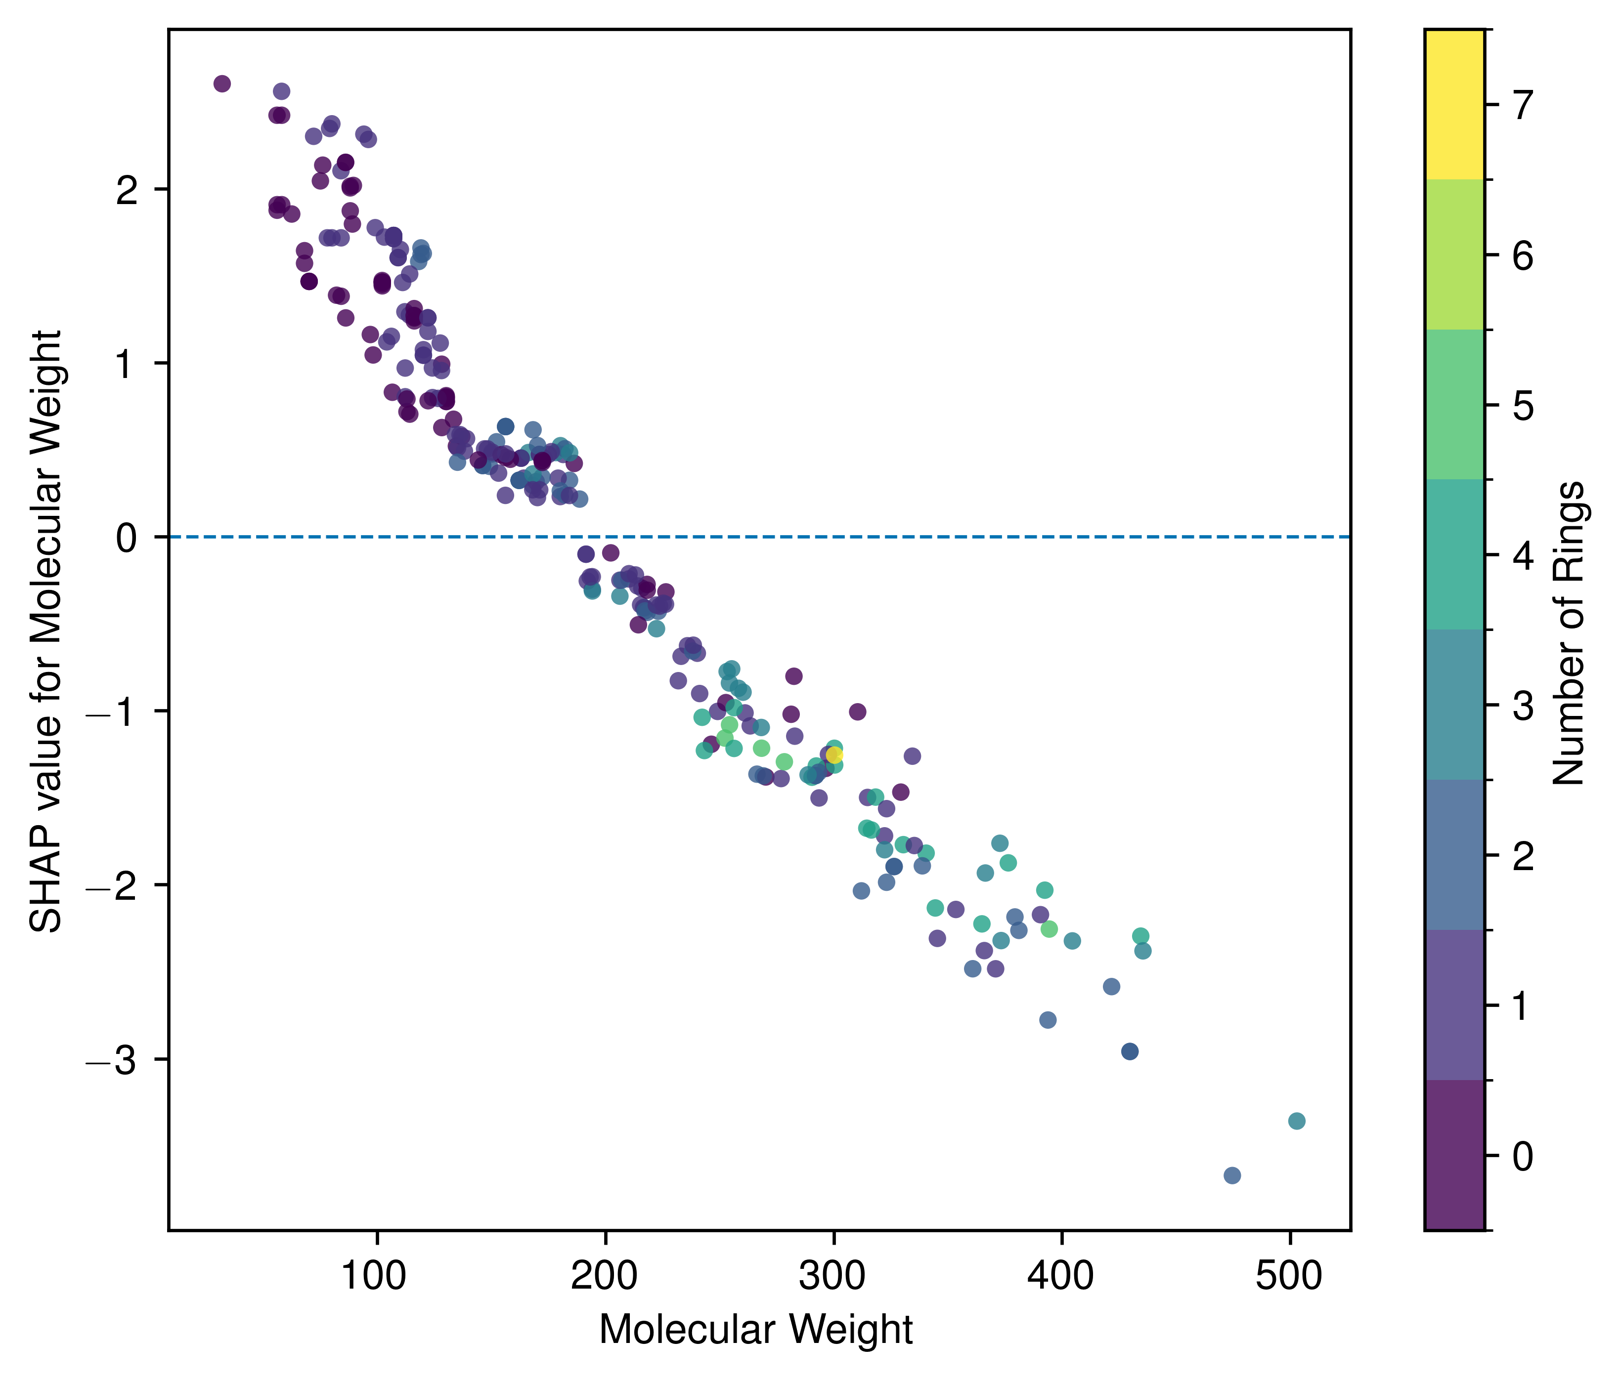
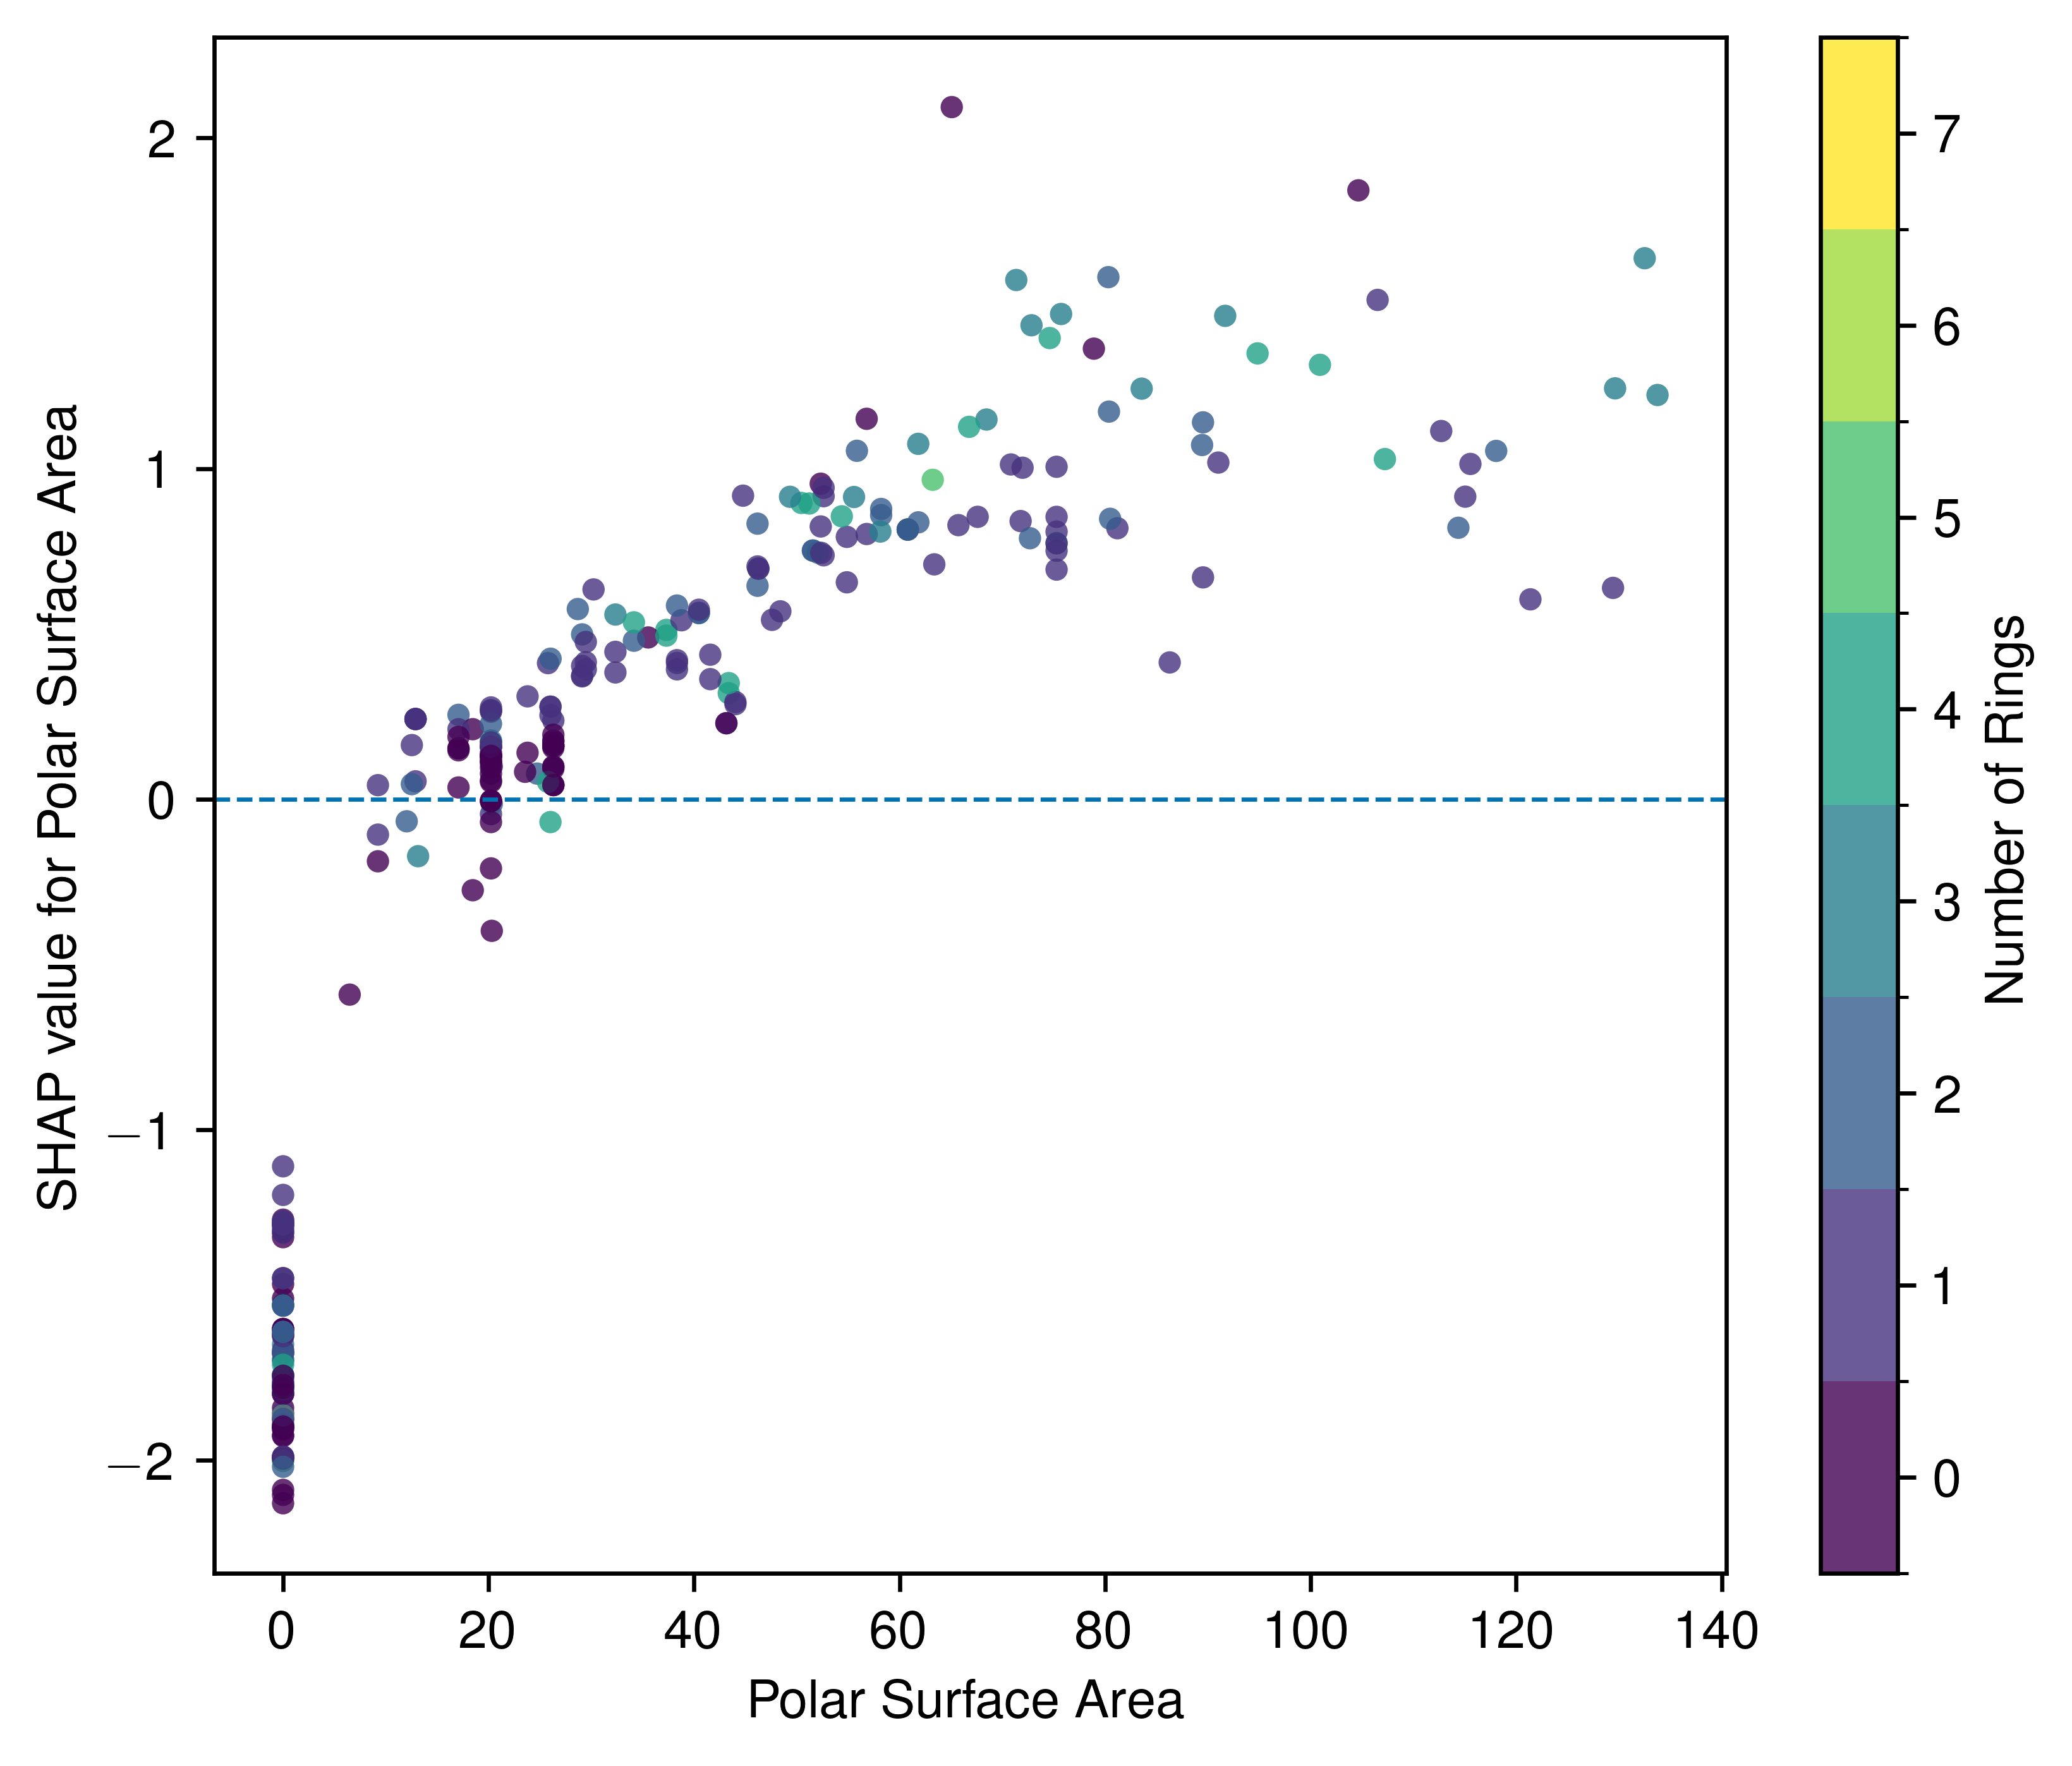
Local & global model-agnostic post-hoc interpretability: SHapley Additive exPlanations (SHAP)

Slide 51
Local & global model-agnostic post-hoc interpretability: SHapley Additive exPlanations (SHAP)
Strengths
Limitations
Provides local additive feature attributions for individual predictions
Works well when you want both local explanations and global summaries from aggregated SHAP values
Helps reveal direction, magnitude, and distribution of feature contributions across samples
Does not prove mechanism or causality; it explains the model’s attribution of a prediction
Sensitive to correlated feature and background/reference distribution

Slide 52
Closing thoughts
Choosing the right model
Question | Method
Which features matter globally? | MDI, permutation importance, mean |SHAP|
How does a feature affect predictions? | ICE/PDP
Why this specific prediction? | LIME, SHAP
Does the model learn chemistry or shortcuts? | Compare methods + domain knowledge
A practical workflow
Start with an interpretable baseline
Compare against flexible models
Use global explanation methods to identify model reliance
Use local explanations to inspect examples and outliers
Check whether explanations make chemical sense
Common failure modes
correlated descriptors split or hide importance
local explanations are treated as global rules
feature attributions are interpreted as mechanisms
visually convincing plots create false confidence

Slide 53
Additional resources
Accumulated local effects (ALE)
Feature-effect plots that reduce extrapolation issues when features are correlated.
Apley & Zhu, JRSS B 2020
Counterfactual explanations
Ask: “What minimal molecular/property change would flip the prediction?”
interpret.ml/DiCE
Explainable Boosting Machines
Interpretable GAM-like models with learned nonlinear feature functions and interactions.
interpret.ml/docs/ebm.html
Integrated gradients / Captum
Attribution methods for neural networks; useful for differentiable molecular models.
captum.ai
GNNExplainer
Subgraph and node-feature explanations for graph neural networks.
arxiv.org/abs/1903.03894
Sanity checks for explanations
Test whether saliency/explanation maps actually depend on the model and data.
Adebayo et al., NeurIPS 2018
Use interpretable models when possible
A cautionary perspective on post-hoc explanations in high-stakes settings.
Rudin, Nat. Mach. Intell. 2019
Benchmark explanation quality
Libraries such as Quantus help compare robustness and faithfulness of explanations.
quantus.readthedocs.io

Slide 54
Extra slides

Slide 55
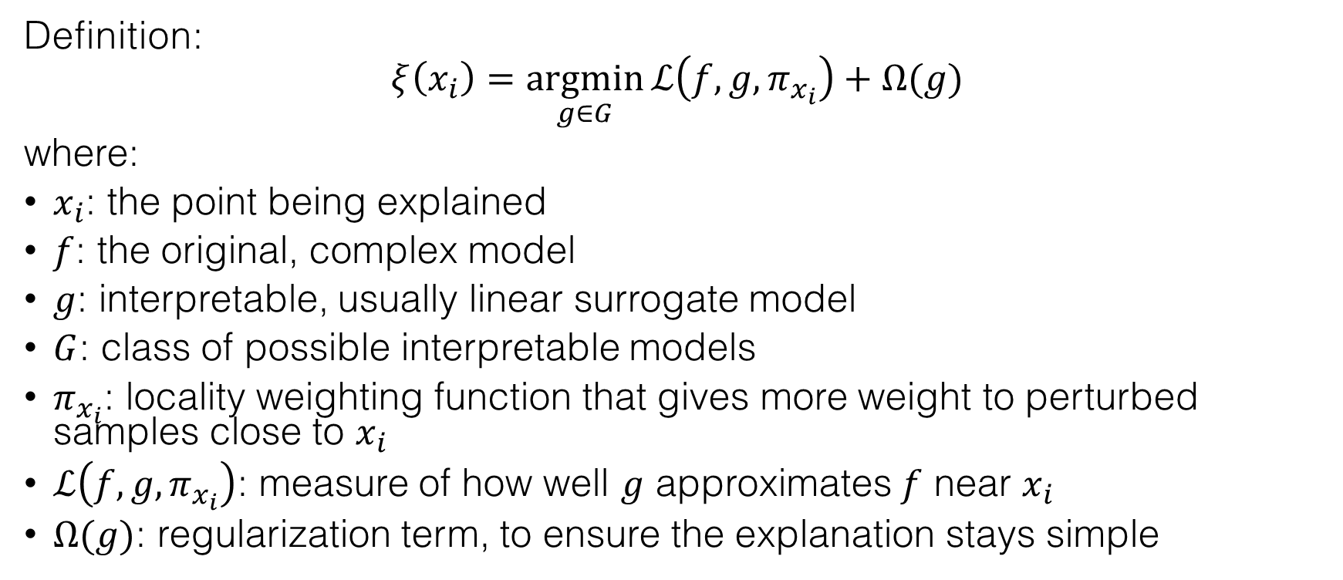
Local model-agnostic post-hoc interpretability: Local Interpretable Model-agnostic Explanations (LIME)
Definition:
$$ξ\left(x_{i}\right)=\underset{g∈G}{argmin}{ℒ\left(f,g,π_{x_{i}}\right)+Ω(g)}$$
where:
$x_{i}$: the point being explained
$f$: the original, complex model
$g$: interpretable, usually linear surrogate model
$G$: class of possible interpretable models
$π_{x_{i}}$: locality weighting function that gives more weight to perturbed samples close to $x_{i}$
$ℒ\left(f,g,π_{x_{i}}\right)$: measure of how well $g$ approximates $f$ near $x_{i}$
$Ω(g)$: regularization term, to ensure the explanation stays simple

Slide 56
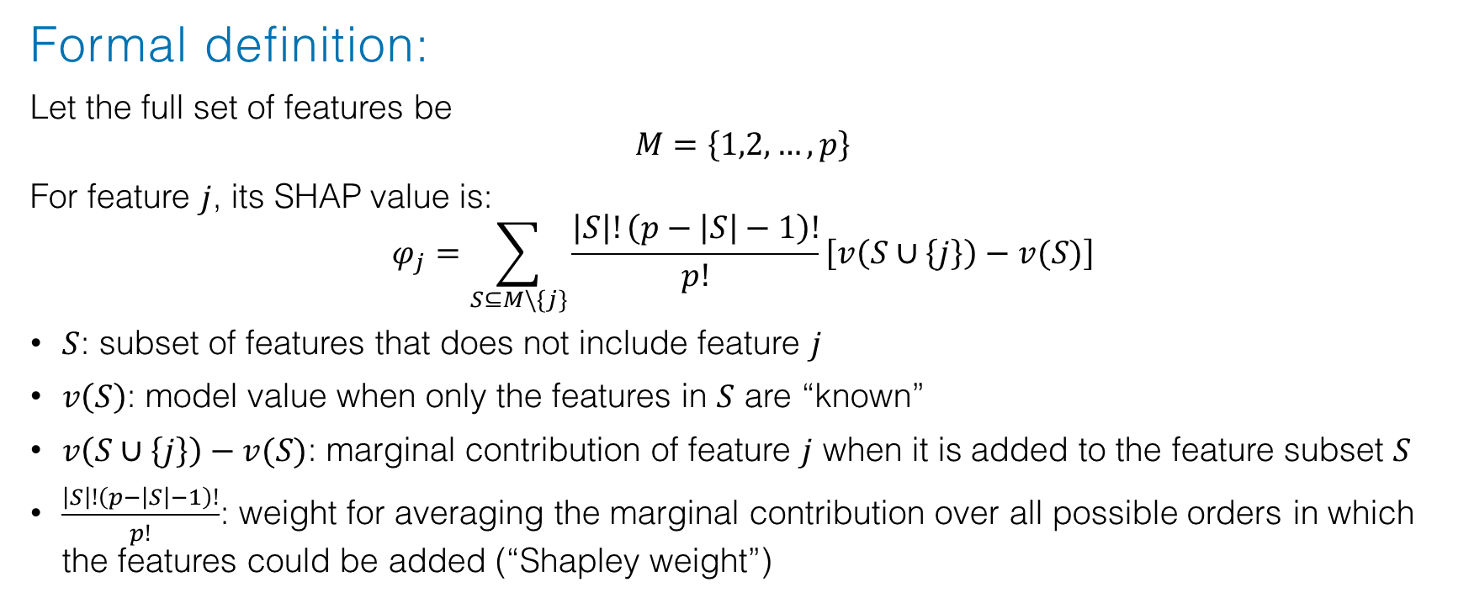
Local & global model-agnostic post-hoc interpretability: SHapley Additive exPlanations (SHAP)
Formal definition:
Let the full set of features be
$$M=\left\{1,2,…,p\right\}$$
For feature $j$, its SHAP value is:
$$φ_{j}=\sum_{S⊆M\backslash \left\{j\right\}}{\frac{\left|S\right|!\left(p−\left|S\right|−1\right)!}{p!}\left[v\left(S∪\left\{j\right\}\right)−v(S)\right]}$$
$S$: subset of features that does not include feature $j$
$v\left(S\right)$: model value when only the features in $S$ are “known”
$v\left(S∪\left\{j\right\}\right)−v(S)$: marginal contribution of feature $j$ when it is added to the feature subset $S$
$\frac{\left|S\right|!\left(p−\left|S\right|−1\right)!}{p!}$: weight for averaging the marginal contribution over all possible orders in which the features could be added (“Shapley weight”)

Slide 57
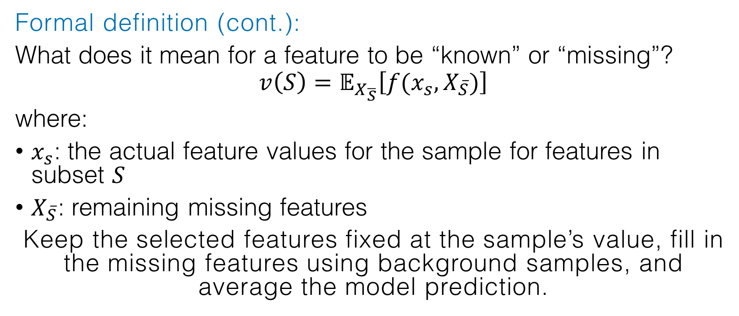
Local & global model-agnostic post-hoc interpretability: SHapley Additive exPlanations (SHAP)
Formal definition (cont.):
What does it mean for a feature to be “known” or “missing”?
$$v\left(S\right)=𝔼_{X_{\overline{S}}}\left[f(x_{s},X_{\overline{S}})\right]$$
where:
$x_{s}$: the actual feature values for the sample for features in subset $S$
$X_{\overline{S}}$: remaining missing features
Keep the selected features fixed at the sample’s value, fill in the missing features using background samples, and average the model prediction.

Slide 58
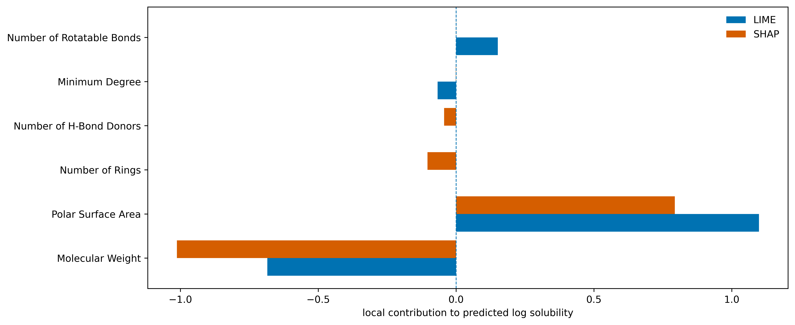
Local & global model-agnostic post-hoc interpretability: SHapley Additive exPlanations (SHAP)

